Slide 1
Cardio-Respiratory Exercise Physiology – Chapter 2
Cardiovascular System

Slide 2
CARDIOVASCULAR SYSTEM
Made up of:
The heart – pumps blood throughout the body
Vascular System – comprised of the blood and circulatory vessels
Lungs – site of gas exchange (alveoli)
Each system works together to ensure adequate amounts of oxygen are delivered to the muscles and tissues of the body

Slide 3
BLOOD
PLATELETS - <1% : used to assist in repair after injury
WHITE BLOOD CELLS (WBC’s) – <1% known as leucocytes : immune function, protects the body from infection
RED BLOOD CELLS (RBC’s) – known as erythrocytes, make up 40-45% of blood volume
Amount of RBC’s in the body is dependent on fitness and gender

Slide 4
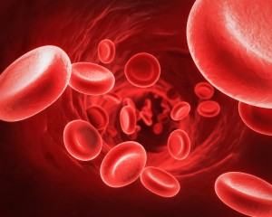
BLOOD FUNCTIONS
Transports gases, nutrients, waste products, hormones, heat
Average blood volume:
~5-6 L in men
~4-5L in women
55% of blood fluid is plasma, 45% is blood cells and platelets

Slide 5
BLOOD FUNCTIONS
Carbon Dioxide (CO2) is transported in the blood in the form of bicarbonate, a buffer that keeps blood from becoming too acidic
O2 is less soluble in plasma, but easily attaches to hemoglobin – an iron-rich pigment
Protects us from bleeding to death, via clotting, and from disease, by destroying invasive microorganisms

Slide 6
BLOOD PLASMA
Contains 90% water along with blood proteins, salt, food substances, waste products, gases (carbon dioxide, oxygen), enzymes and antibodies
Main Function of plasma is to transport blood cells through the body

Slide 7
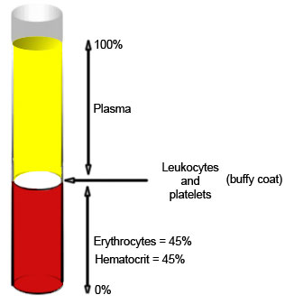
HEMATOCRIT
Hematocrit: percentage of total blood volume composed of platelets, red, and white cells.
Normal range is 41-50% in men and 36-44% in women

Slide 8
BLOOD
Q & A:
What is EPO? And what does it do?
Why is it advantageous for an endurance athlete to have a higher concentration of RBC’s?
How can an athlete naturally increase their RBC stores?
What are some ways athletes are illegally increasing their RBC count?
https://www.youtube.com/watch?v=G7KZxIR1t-o
Notes:
https://www.youtube.com/watch?v=PgI80Ue-Amo

Slide 9
CIRCULATION
ARTERIES: thick muscular vessels that transport blood away from the heart
Arteries pass blood to smaller vessels called arterioles, and then to capillaries where gas exchange occurs
CAPILLARIES: narrow vessels with thin walls; site of exchange between blood and tissue
VEINS: carry deoxygenated blood toward the heart, less muscular, flexible and have valves to prevent back flow

Slide 10
CIRCULATION PATHWAY
ARTERIES
ARTERIOLES
CAPILLARIES
VENUOLES
VEINS

Slide 11
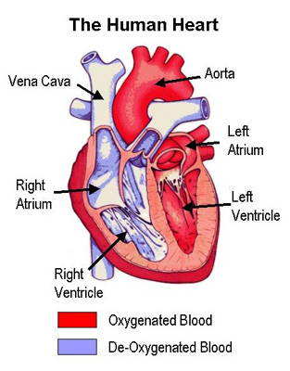
THE HEART
Pear-shaped organ found in the thoracic cavity
Positioned slightly to the left of the body deep to the sternum, between the lungs
Involuntary muscle with striated muscle fibres
Comprised of 4 chambers, 4 valves, and several veins and arteries

Slide 12
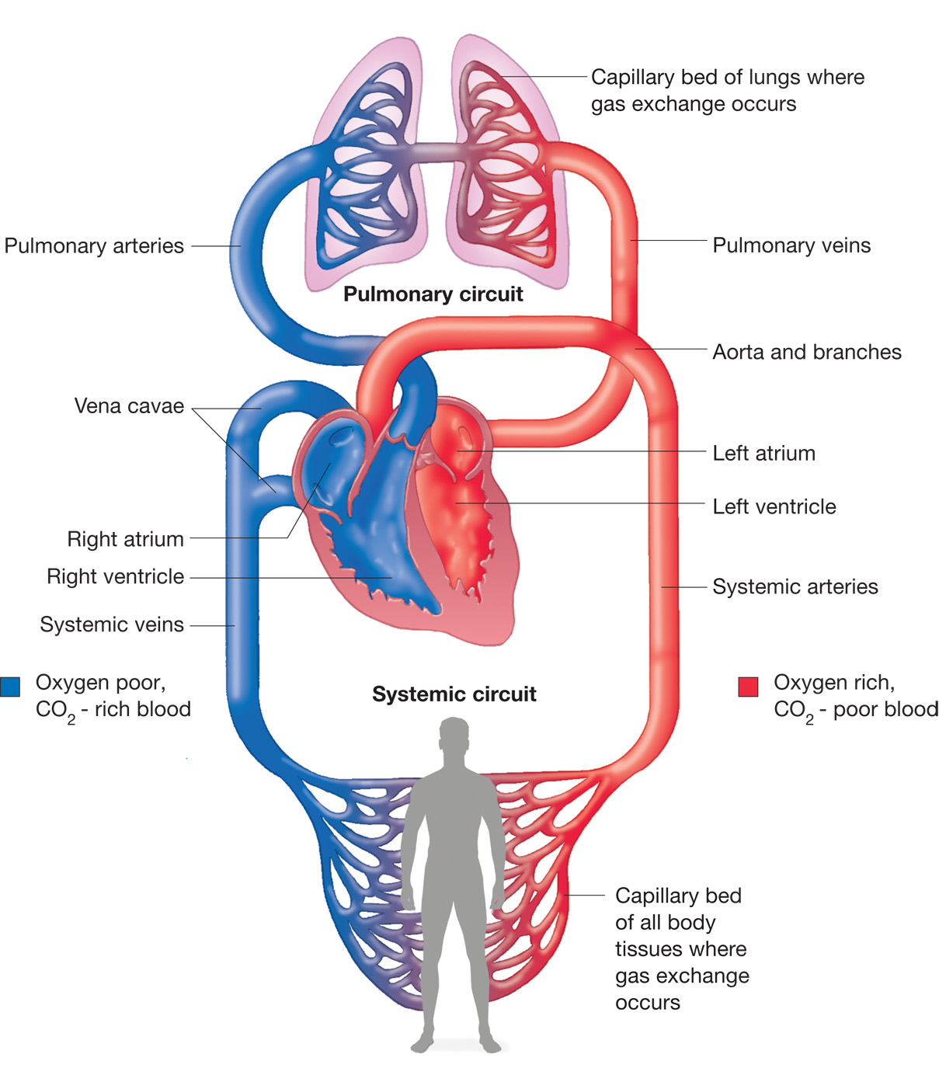
HEART CIRCULATION
PULMONARY CIRCULATION: delivers de-oxygenated blood from the right side of the heart to the lungs
SYSTEMIC CIRCULATION: delivers the oxygenated blood from the left side of the heart to the body

Slide 13
FUNCTIONS OF THE HEART
Generates Blood Pressure
Routes blood around the body
Regulates blood supply

Slide 14
ANATOMY OF THE HEART
Heart consists of three layers:
1. Pericardium- outer double layer bag or membrane containing fluid. Functions to reduce friction and maintain heart shape
2. Myocardium (Cardiac Muscle)- contracts the same way as skeletal muscle. Receives stimulus from the CNS to the hearts pacemaker. Works in a all or none principle)
3. Endocardium- smooth inner membrane. Functions to prevent friction between heart muscle and blood

Slide 15
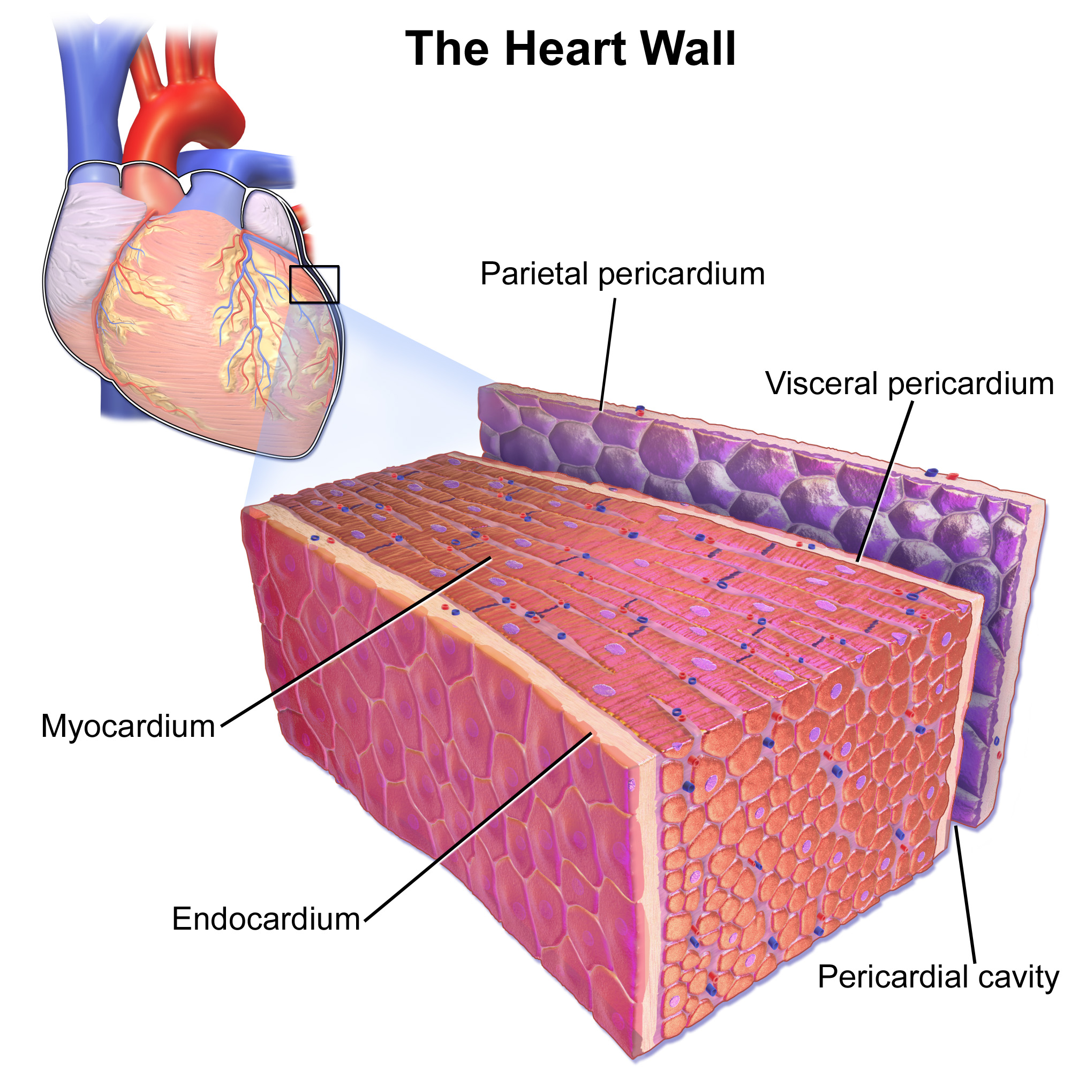

Slide 16
HOW THE HEART WORKS VIDEO
https://www.youtube.com/watch?v=7XaftdE_h60

Slide 17
ANATOMY OF THE HEART: Heart Chambers
1) Left Atrium- receives oxygen rich blood from the lungs through the pulmonary veins.
2) Left Ventricle- receives oxygenated blood from left atrium through the bicuspid valve. Pumps blood to the body through the aortic valve to aorta
3) Right Atrium- receives de-oxygenated blood from the body through the superior and inferior vena cava.
4) Right Ventricle- receives de-oxygenated blood from the right atrium through the tricuspid valve. Send blood to lungs through the pulmonary artery

Slide 18
ANATOMY OF THE HEART: Heart Valves
1) Bicuspid (Mitral) Valve- One way valve allowing blood flow from the left atrium to the left ventricle
2) Aortic Valve- One way valve allowing blood flow from the left ventricle to the aorta
3) Tricuspid valve- one way valve allowing de-oxygenated blood to move from the right atrium to the right ventricle
4) Pulmonary Valve- one way valve allowing de-oxygenated blood to move from the right ventricle to the lungs

Slide 19
ANATOMY OF THE HEART: Veins and Arteries
Vena Cavae (Superior and Inferior) – deliver de-oxygenated blood from the body into the right atrium
Pulmonary Arteries- deliver de-oxygenated blood from the right ventricle to the lungs
Pulmonary Veins – deliver oxygenated blood from the lungs into the left atrium
Aorta – delivers oxygenated blood from the left ventricle to the body

Slide 20
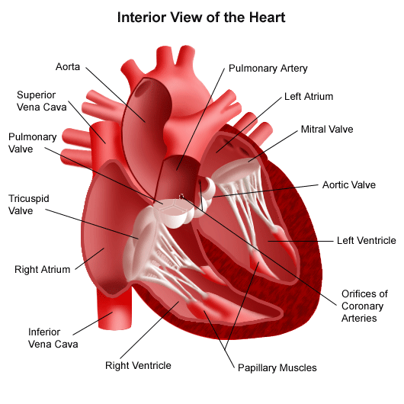

Slide 21
HEART CONTRACTION
The heart can actually beat on its own, outside the body of an individual for several hours if supplied with proper nutrients and salts…
The reason for this is the heart makes itself contract and this process is called a MYOGENIC contraction
The contractions of the heart chambers contract in a sequence initiated from the pacemaker

Slide 22
CARDIAC IMPULSES
SINOATRIAL NODE (SA NODE) – found in the wall of the right atrium and acts as the hearts pacemaker because it initiates each heart beat
ATRIOVENTRICAL NODE (AV NODE) – found near the bottom of the right atrium. Receives electrical signal from the SA node and passed onto the Bundle of His and Purkinje Fibres
PURKINJE FIBRES – deliver electrical signal to the cardiac muscles which signals the ventricles to contract

Slide 23
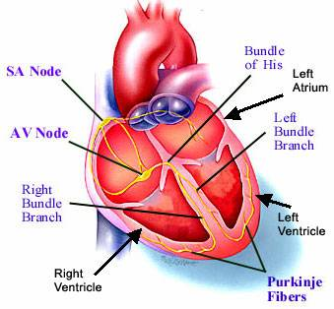

Slide 24
CARDIAC CYCLE
Defined as the order of events that make up one heart beat.
Cycle lasts for ~0.8 seconds and occurs ~72 times a minutes
Consists of a period of relaxation, known as diastole (0.5 sec), followed by a period of contraction, known as systole (0.3 seconds)

Slide 25
DIASTOLE: RELAXATION
Period of relaxation when the heart, specifically the atria refill with blood
Tricuspid and bicuspid valves are closed at this time
The one way valves are pushed open due to increased atrial pressure
As a result, ventricles begin to fill with blood

Slide 26
SYSTOLE: CONTRACTION
ATRIAL SYSTOLE:
SA node sends an electrical impulse to the atrium walls signaling them to contract
Resulting contraction causes atrioventricular valves (bicuspid and tricuspid) close once all blood has been forced into the ventricles
VENTRICULAR SYSTOLE:
Pressure inside the ventricles pushes open the semilunar valves (Pulmonary and aortic)
Electric signal travels down the Purkinje Fibers stimulates contraction of the ventricular myocardium
Blood flows into the pulmonary (lungs) and systemic (around the body) systems.

Slide 27
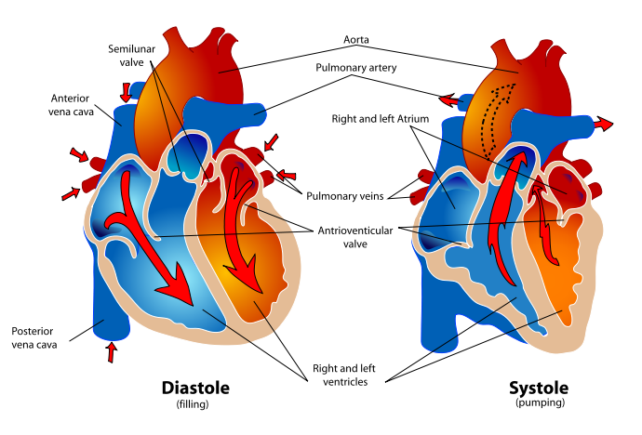

Slide 28
CARDIAC CYCLE VIDEO
https://www.youtube.com/watch?v=fZT9vlb2ua

Slide 29
FACTORS AFFECTING HEART RATE
Heart contraction rate is affected by hormones and the nervous system
PARASYMPATHETIC (PNS): PNS is part of the Autonomic Nervous System (ANS) that functions to bring the body systems to rest. (REST and DIGEST). It helps to bring the heart rate down during recovery by acting on the SA node.
SYMPATHETIC NERVOUS SYSTEM (SNS): SNS prepares your body for action (FIGHT or FLIGHT). SNS functions by sending a signal from the cardiac centre to the hearts pace maker in response to increased demand of oxygen.

Slide 30
FACTORS AFFECTING HEART RATE
Cardiac centre is found in the MEDULLA OBLONGATA
SNS: during exercise, sympathetic nerves release noradrenalin, a neurotransmitter onto the SA node which increases heart rate
PNS: during recovery the PNS sends impulses down the vagus nerve, which slows the heart rate and helps to bring the body back to rest levels and homeostasis

Slide 31
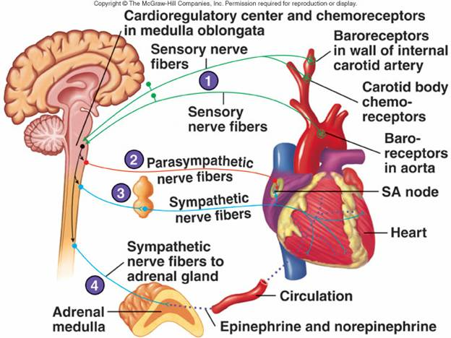
Nervous System Control of the Heart

Slide 32
FACTORS AFFECTING HEART RATE
During intense exercise, adrenaline affects the heart rate in the body
When the body is preparing for action, adrenaline is released
This release reduces blood flow to the organs that are not needed or important for the activity and increases the blood flow necessary to skeletal muscle, cardiac muscle and lungs

Slide 33
BE SURE TO KNOW!
Name the function of the following:
Sinoatrial Node
Atrioventricular Node
Purkinje Fibres
Describe what takes place during different stages of the cardiac cycle
Diastole
Atrial and Ventricular Systole
Understand and be able to distinguish between the sympathetic and parasympathetic nervous systems, and the affect they have on heart rate

Slide 34
BE SURE TO KNOW!
Describe the make up of our blood
Describe the function of the following:
Erythrocytes (RBC’s)
Leukocytes (WBC’s)
Platelets

Slide 35
SOUNDS OF THE HEART
Through a stethoscope, the heart sounds are generally described as “lub-dub”
The “lub” sound comes from the closing of the tricuspid and bicuspid valves
The “dub” sound is caused by the closing of the pulmonary and aortic valves (semilunar)
TO DO: Page 40
Heart Rate according to stethoscope: _______________ bpm

Slide 36
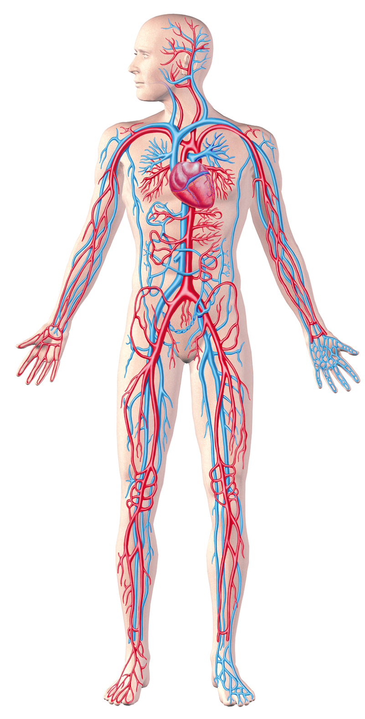
BLOOD DISTRIBUTION
Blood flow distribution is based on which tissues are in greatest need
During exercise, blood flow to working muscles increases up to 80% of all blood circulating through the body (Cardiac Output)
At rest, kidney and liver receive ~ half of cardiac output while skeletal muscles only receive 15-20% of cardiac output

Slide 37
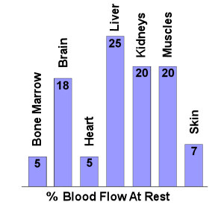
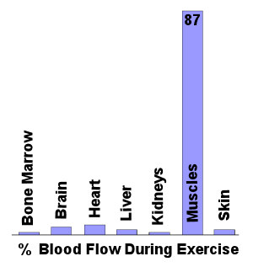
BLOOD FLOW AT REST vs. EXERCISE

Slide 38
BLOOD PRESSURE
BP is defined as the amount of pressure exerted by blood on the vessel walls
Expressed by 2 numbers:
Systolic Blood Pressure
Diastolic Blood Pressure
Also referred to as ARTERIAL BLOOD PRESSURE

Slide 39
BLOOD PRESSURE
Resting, healthy adult range for blood pressure is generally 120 mmHg(systolic) to 80 mmHg(diastolic), and is read as “120 over 80 mmHg”
Blood pressure within this range is considered to allow efficient emptying and filling of the heart, but still maintaining enough pressure to send blood to the working tissues in the body.
Low blood pressure: 90-100/50-60 mmHg
High blood presure: 140/100 mmHg

Slide 40
BLOOD PRESSURE: Systolic vs. Diastolic
SYSTOLIC PRESSURE: process of ventricle contracting and forcing blood into the aorta
Systolic pressure represents highest pressure
DIASTOLIC PRESSURE: ventricle relaxes allowing for chambers to fill up with blood
Diastolic pressure represents lowest pressure
Important to note that systolic blood pressure will increase with exercise and training, while diastolic stays consistent

Slide 41
BLOOD PRESSURE
Q & A
TO DO: Green box, 41
What is your blood pressure?
Explain what happens to blood flow distribution during exercise?
Answer questions #1-5 in green box on 41.

Slide 42
CARDIAC OUTPUT
Cardiac Output (Q): the amount of blood pumped from the heart in one minute. Cardiac output is measured in liters and considers all blood except that which goes to the lungs
Cardiac Output (Q) = (Stroke Volume x Heart Rate) / 1000
Stroke Volume (SV): the amount of blood being pumped by each ventricle with each contraction
Heart Rate = 1 Cardiac Cycle

Slide 43
CARDIAC OUTPUT DURING EXERCISE
On average, cardiac output is ~5L per min at rest and can increase to 30L per min during strenuous exercise
Why does cardiac output increase during exercise??
As heart rate increases, so does stroke volume, therefore resulting in an increase in cardiac output.
However, during endurance activities where the intensity and demand remains the same over time, cardiac output does not increase further.

Slide 44
CARDIAC DRIFT
During endurance activities where cardiac output stays constant, heart rate will eventually increase slightly and progressively
As the heart rate begins to ‘drift’ upward, the stroke volume decreases, which allows for cardiac output to remain the same
Sweating → Thermoregulation → Heart rate increase
Complete P.43 TO DO green box in text

