Slide 1
Introduction to Musculoskeletal Anatomy
IB SEHS

Slide 2
Starter
The anatomical starting position:
1. Draw the outline of a person (see above).
Label the outline with following terms:
-head -trunk -arm
-neck -forearm -hand
-trunk -thigh -leg
-foot

Slide 3
Learning Objectives
Everyone should
Apply anatomical terminology to the location of various body parts
Most will:
State the different functions of the skeletal system

Slide 4
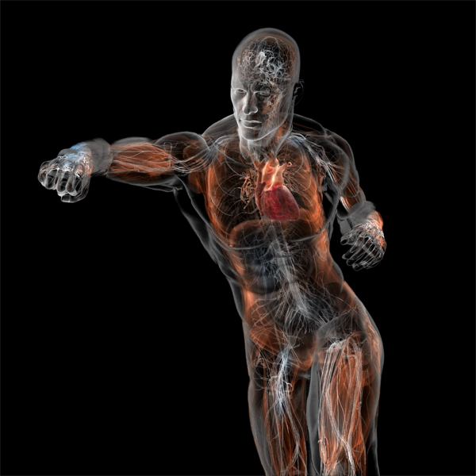
The Musculoskeletal system
Skeletal system:
Bones
Joints
Muscular system
Muscles
Muscles cross joints and pull on bones causing movement of joints
To understand how bones and muscles are involved in sporting actions we need to know the location and structure of specific muscles and bones and the way they work together.

Slide 5
Anatomical starting position
head
neck
trunk
arm
forearm
hand
thigh
leg
Now copy this into your workbook!
foot

Slide 6
Pairs activity
Look at your anatomical starting position diagram.
In turns, try and describe the location of a body part
Try and do this by relating its position to another body part
e.g. your neck is below your head
What kind of words did you use to help you do this?
Prepositions?

Slide 7
Now copy this into your workbook!

Slide 8
Internal | Located inside or further away from the surface | The heart is internal to the ribcage
External | Located on or near the surface | The male reproductive system is external to the body
Now copy this into your workbook!

Slide 9
Pairs activity
Describe the following locations of the body using proper anatomical terminology.
The head as compared to the neck
The heart as compared to the ribs
The shoulder as compared to the elbow
The thumb as compared to the pinky
The skin as compared to the muscles
The nose as compared to the ears
The foot as compared to the knee

Slide 10
Planes
Imaginary flat surfaces that divide the human body
They are used to:
divide the body for further identification of particular areas
describe different movements or actions
Always refer to the body in the anatomical position

Slide 11
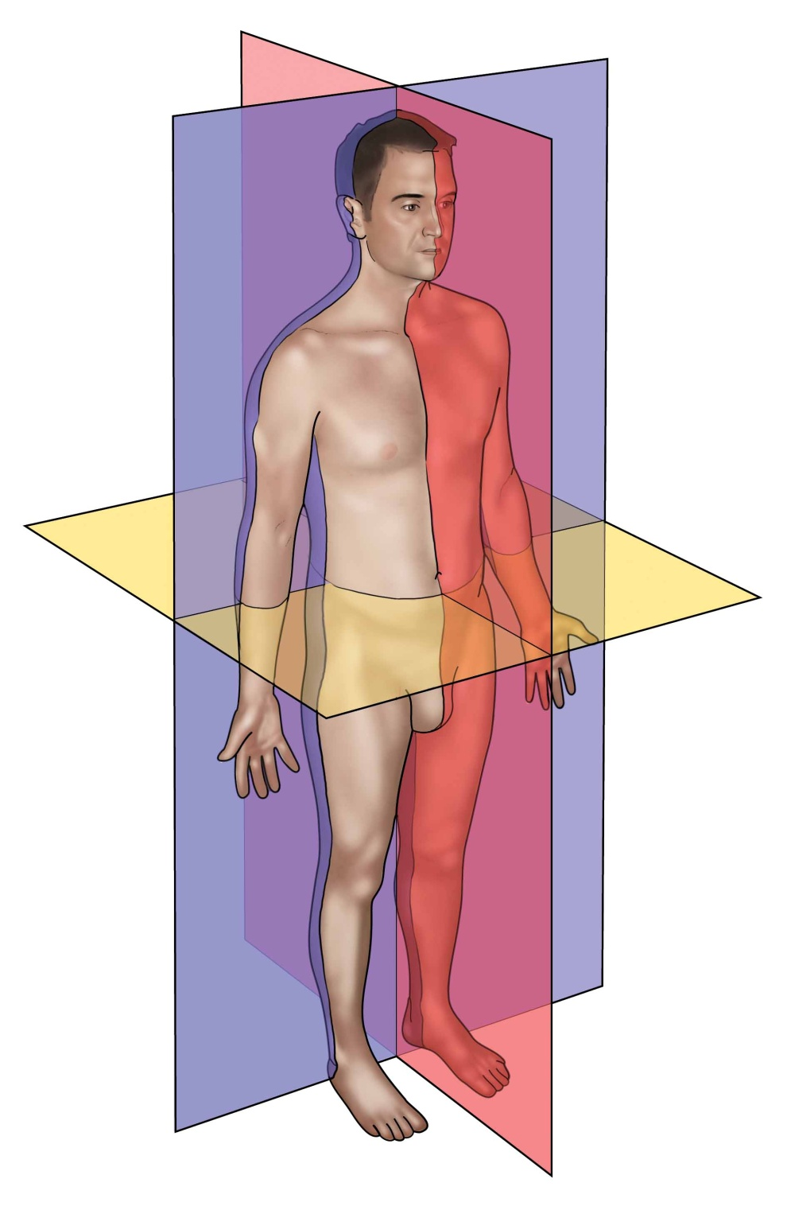
Median
Plane
Median plane or midsagittal plane
A vertical plane that bisects the body into equal right and left halves
– Sagittal plane is any plane parallel to the median plane

Slide 12
Frontal plane
A vertical plane that bisects the body into front and back
Coronal Plane
– It is at right angles to
the median plane

Slide 13
Transverse plane or horizontal plane
A horizontal plane that bisects the body into top and bottom
It is at right angles to both the median and coronal planes
Transverse Plane

Slide 14
Centre of gravity
The point at which the median, frontal, and transverse planes intersect

Slide 15
Movements

Slide 16
Movement around a joint may be around any one (or more) of three axes
Y
X
Z
Most movements are found in pairs – for every movement, there is generally a movement that is opposite to it

Slide 17
Planes and Axis of the Body
Plane | Axis | Description
Sagital (anteroposterior) | Frontal | Bisects the body from front to back, dividing it into left and right halves. Flexion/extension movements occur here.
Frontal / Coronal | Sagittal | Bisects the body laterally from side to side, dividing it into front and back halves. Abduction/adduction movements occur here.
Transverse / Horizontal | Longitudinal (vertical) | Divides the body horizontally into superior and inferior halves. Rotational movements occur here.

Slide 18
Give an example of movements in sport/fitness that occur in each plane

Slide 19
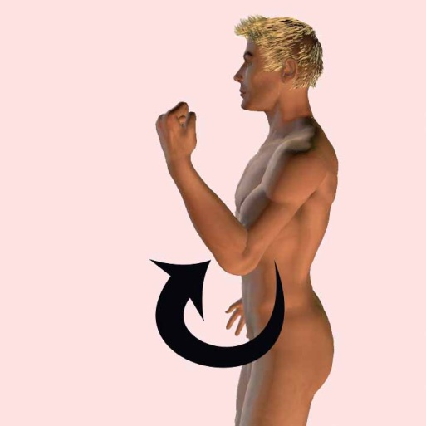
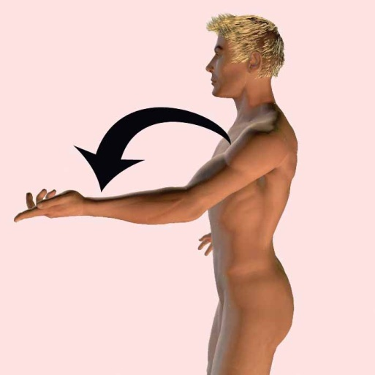
Flexion-Extension
Flexion – reduces the angle between two bones at a joint
Extension – increases the angle between two bones at a joint
Flexion
Usually a sagittal plane movement
E.g., Biceps curl
Lifting the weight reduces the angle at the joint = flexion
Lowering the weight increases the angle at the join = extension
Extension

Slide 20
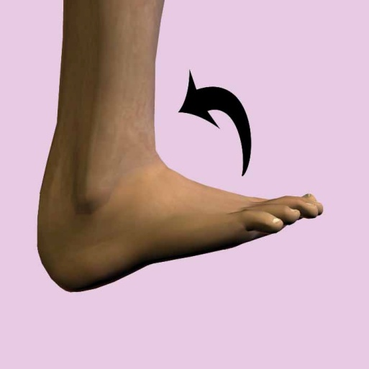
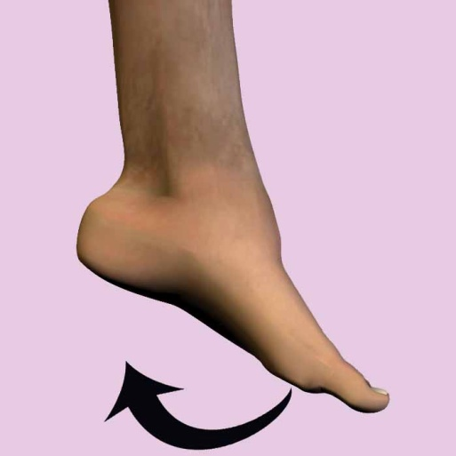
Dorsiflexion-Plantar flexion
Modified flexion with respect to the ankle joint
Dorsiflexion – bringing the top of the foot toward the lower leg or shin
Dorsiflexion
Plantar flexion – “planting” the foot
Plantar Flexion

Slide 21
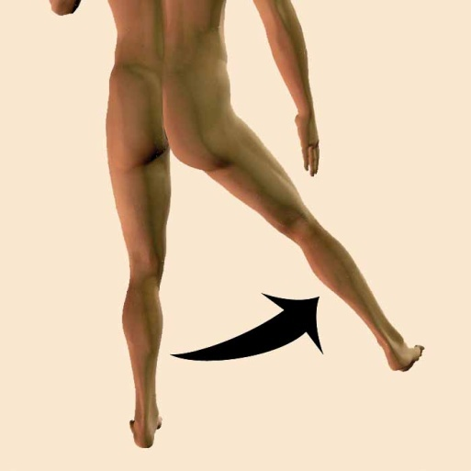
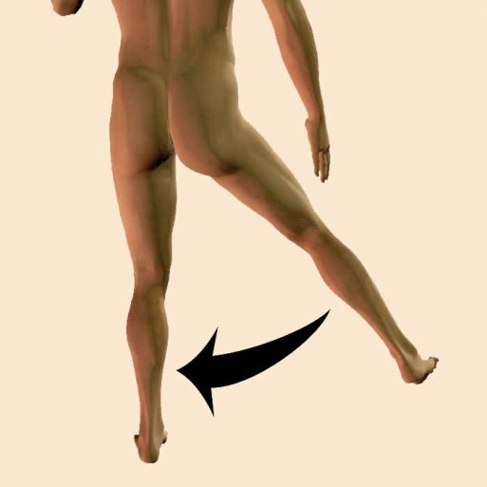
Abduction-Adduction
Abduction – moving a segment away from the midline of the body
Adduction – moving segment toward the midline of the body
Abduction
Frontal plane movement
E.g., The motions of the arms and legs during a jumping jack
Hint:
Abduct = “take away” from the midline
Adduct = “add” toward the midline
Adduction

Slide 22
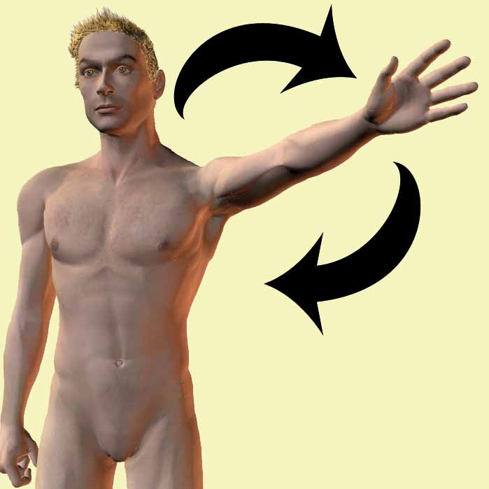
Circumduction
A cone of movement that does not include any rotation
Occurs when flexion-extension movements are combined with abduction-adduction movements
E.g., Tracing an imaginary circle in the air with your index finger
The tip of your finger represents the base of the cone, while your knuckle forms the apex of this conical motion

Slide 23
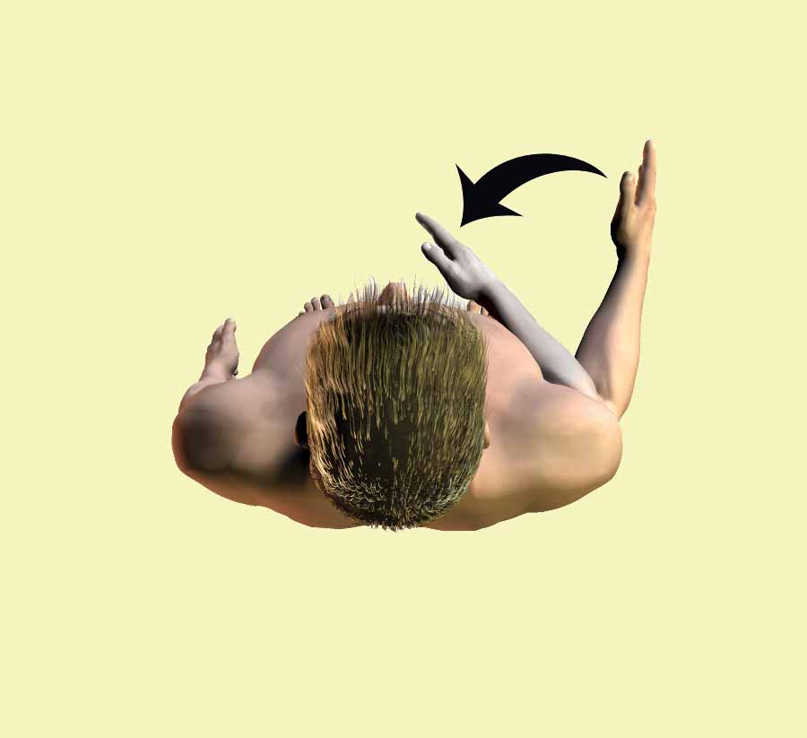
Rotation
Turning a bone along its longitudinal axis
Medial rotation – rotation toward the midline
Lateral rotation – rotation away from the midline

Slide 24
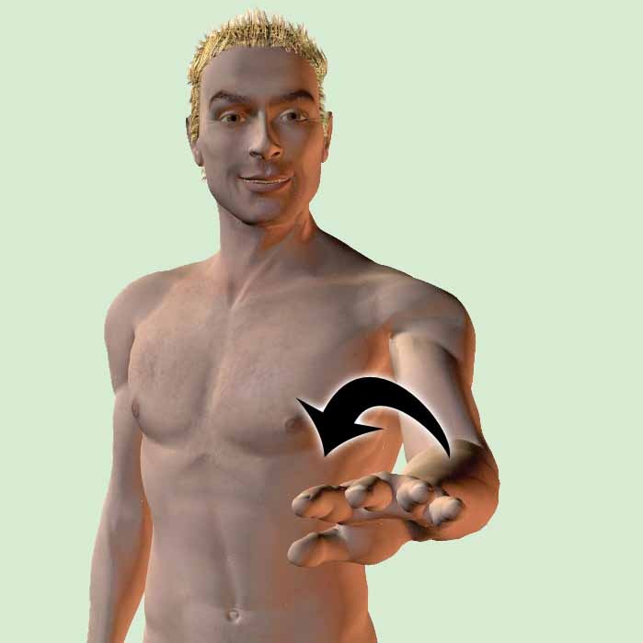
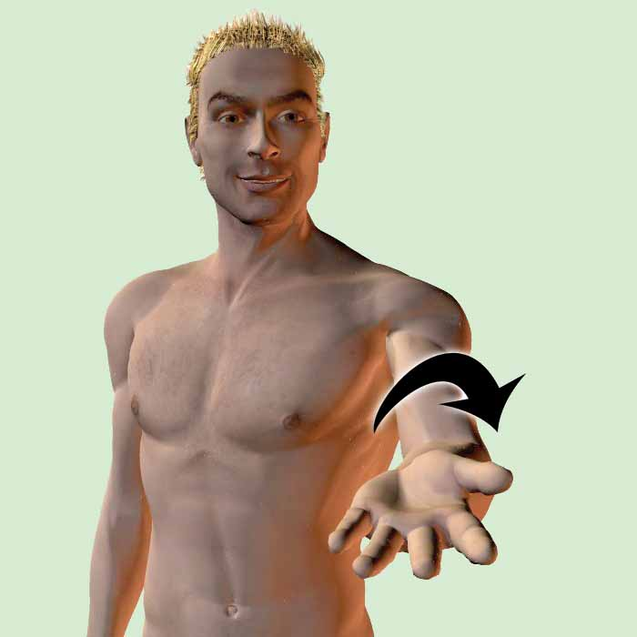
Pronation-supination
Movements related to the forearm and hand
Pronation – when the palm is moved to face posteriorly
Supination – when the palm is moved to face anteriorly (Hint: you can hold a bowl of soup)
Pronation
Supination

Slide 25
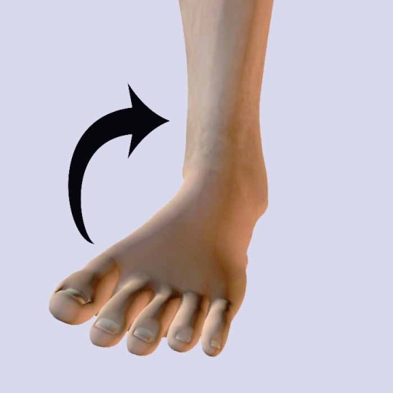
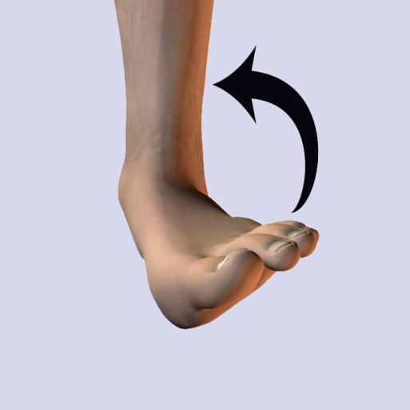
Inversion-Eversion
Movements related to the sole of the foot
Inversion – When the sole is turned inward (as when you "go over" on your ankle)
Inversion
Eversion – When the sole is turned outward or away from the median plane of the body
Eversion

Slide 26
The Skeleton
There are five functions of the Skeleton
1
Shape / Support
2
Storage
3
Protection
4
Movement
5
Blood cell production

Slide 27
Functions of the Skeleton
Protection of vital organs
The skeleton protects the most important internal organs from injury.
Attachment point for muscles
-bones connected by ligaments
-muscles run from one bone to another
-connected to bones via tendons
-muscle/tendon contraction causes joint movement
Now copy this into your workbook!
Storage
1) mineral homeostasis
bones act as reservoirs storing vital minerals such as calcium and phosphorus
used for muscle contraction and nerve activity.
2) energy storage
lipids stored inside yellow bone marrow
located inside long bones
Blood Cell Production (haemopoeisis)
-RBCs, WBCs and platelets produced in red bone marrow
-found in plat bones (e.g. ribs) and the end of long bones (e.g. femur)
Shape / Support
-skeleton serves as the structural framework for the body
-each part bears the weight of all the structures above it
-bones get bigger as you move down the body
₋

Slide 28
Time to mark off Learning Outcomes
Everyone should:
Apply anatomical terminology to the location of bones.
Most will:
State the different functions of the skeletal system

Slide 29
STARTER: GROUP ACTIVITY
Using the list of bones in the box below, use the ‘post-it’ labels to mark the bone location on a member of your team
Skull/cranium | Pelvis | Femur
Ribs | Ulna | Tibia
Vertebral column | Sternum | Fibula
Clavicle | Radius | Patella
Scapula | Humerus

Slide 30
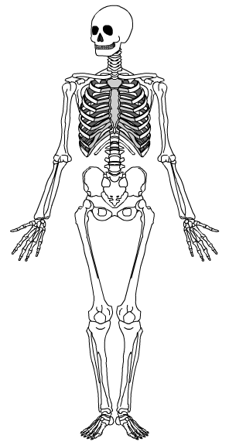
Naming bones
Test yourself!
Use pencil to try to name as many bones as you can think of!
Notes:
Encourage students to learn both the common name and scientific name of each bone.

Slide 31
Naming bones
Cranium (skull)
Clavicle (collar bone)
Sternum (breast bone)
Ribs
Humerus
Pelvis
Radius
Ulna
Patella
(knee cap)
Femur
Tibia
Fibula
Notes:
Encourage students to learn both the common name and scientific name of each bone.

Slide 32
Learning Outcomes
Everyone should:
Identify the axial skeleton
Apply anatomical terminology to the location of bones.
Most will:
Describe the functions of the axial skeleton
Distinguish between the vertebrae and intervetebral discs

Slide 33
The skeletal system
Made up of 4 parts
-bones -cartilage
-ligaments -joints
Skeleton
forms the framework of the body
Comprised of 206 bones grouped into two main parts
1. The axial skeleton (80 bones)
2. The appendicular skeleton (126 bones)

Slide 34
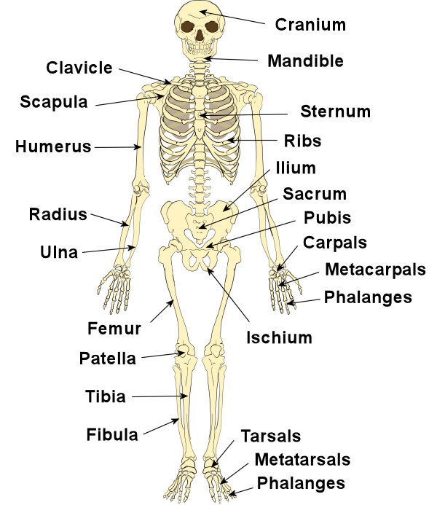
Pelvic girdle
Now label the skeleton in your workbook

Slide 35
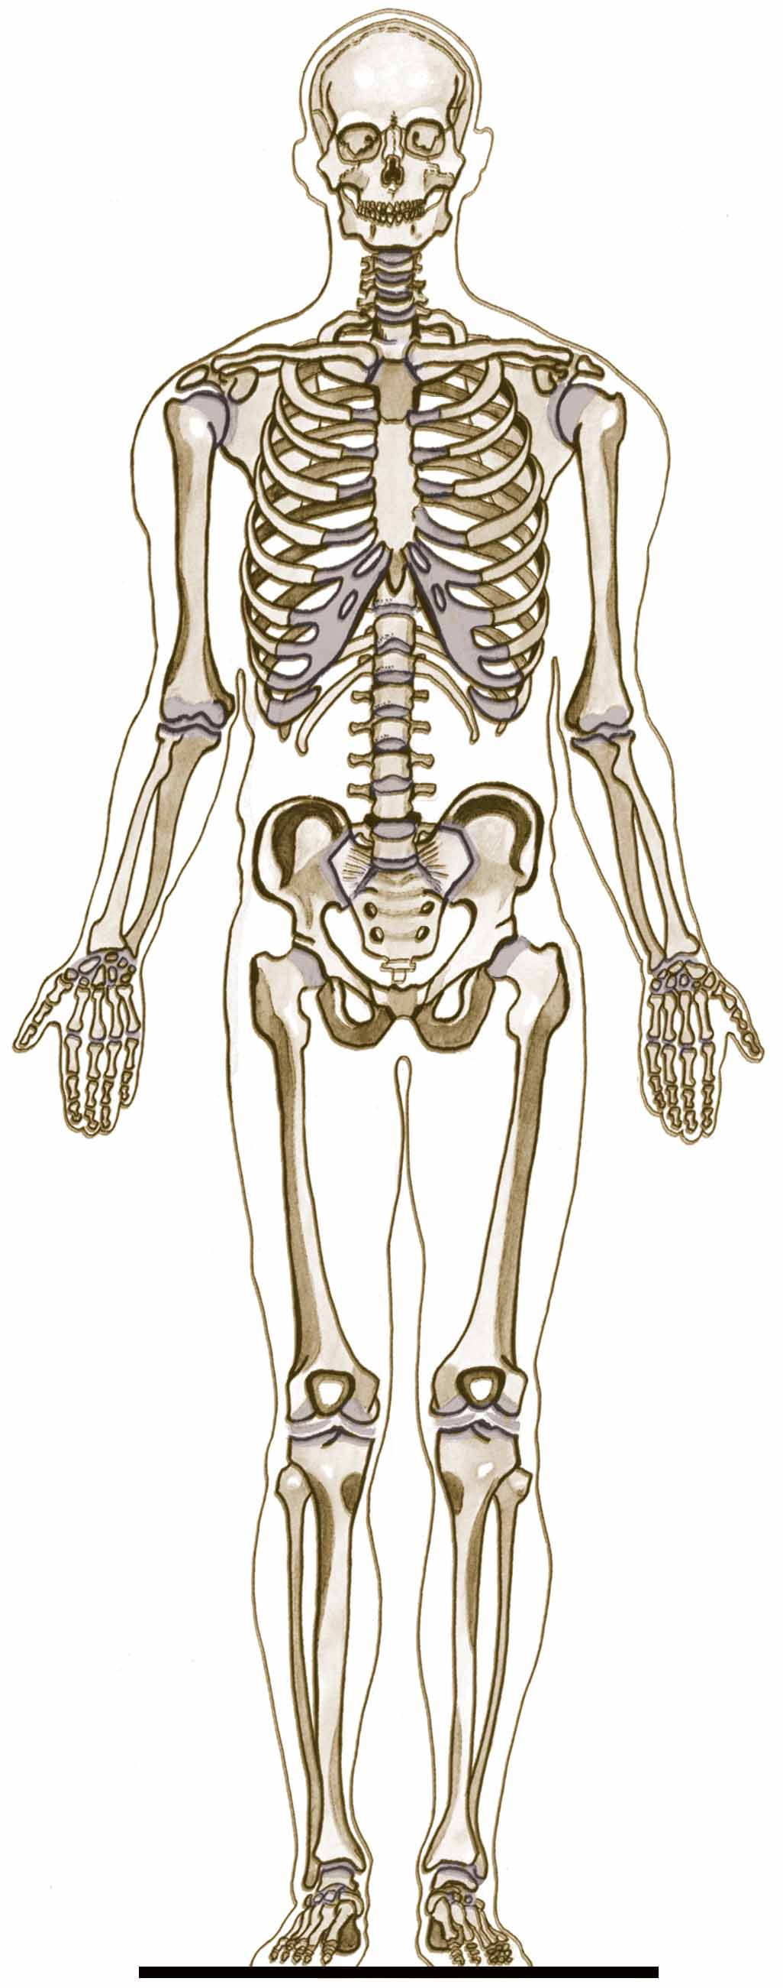
Axial Skeleton
Skull
Forms the main core of the skeletal system and is more rigid than the appendicular skeleton.
Comprising of:
Vertebral column (spine)
Cranium (skull)
Thoracic (rib cage)
Sternum (breast bone)
Sternum
Ribs
Vertebral Column
Now color in the axial skeleton in your workbook

Slide 36
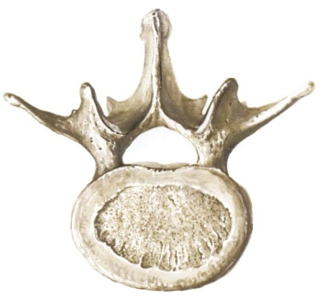
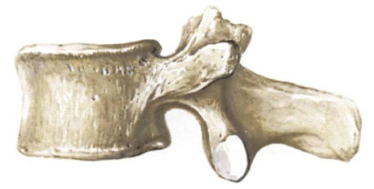
Vertebral Column – 33 vertebrae in total
7 Cervical Vertebrae (of the neck)
Lumbar vertebra, superior view
12 Thoracic Vertebrae (of the chest)
5 Lumbar Vertebrae (of the lower back)
Lumbar vertebra, lateral view
5 Sacrum (mid-line region of buttocks)
4 Coccyx (fused vertebrae of the tail bone)

Slide 37
Vertebral Column
Vertebrae are arranged in a cylindrical column interspersed with fibrocartilaginous (intervertebral) discs
Function:
Provides strong and flexible support for the body and the ability to keep the body erect. Support the head.
The point of attachment for ribs and muscles of the back
Protects the spinal cord and nerves
Absorbs shock through the intervertebral discs without causing damage to other vertebrae

Slide 38
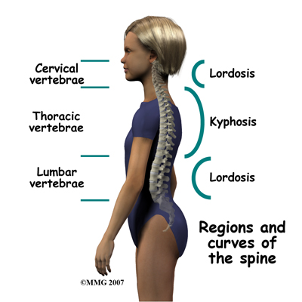
Curves of the Spine

Slide 39
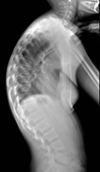
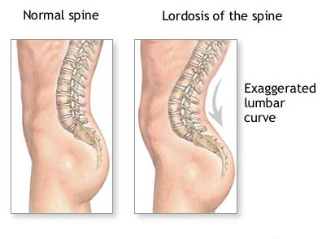
Lordosis
Kyphosis
Scoliosis

Slide 40
Skull
Divided into two parts:
a) Cranium
b) Face

Slide 41
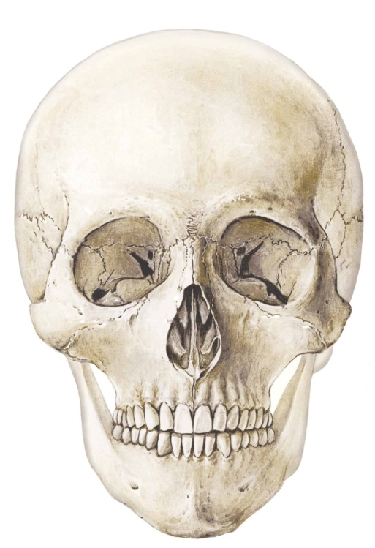
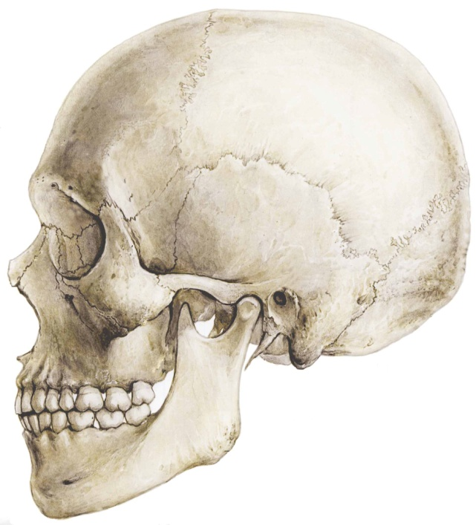
a) Cranium
Parietal Bone
Frontal Bone
Occipital Bone
Temporal Bone

Slide 42
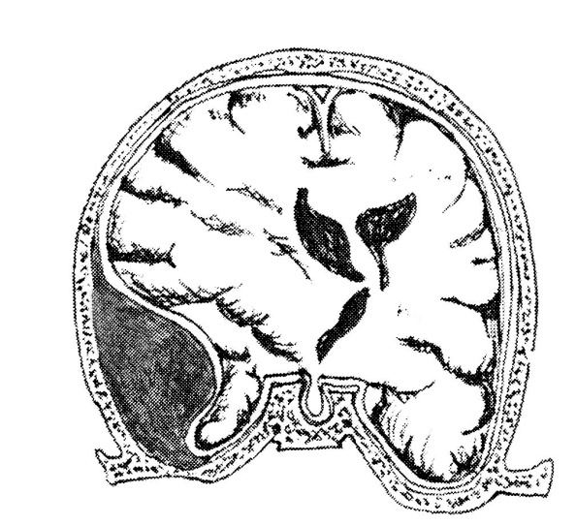
Cranium
May be fractured in blows to the skull (e.g., being checked and hitting the skull on the ice in hockey)
Temporal bone:
Most fragile of the cranium bones
Overlies one of the major blood vessels
If fractured and displaced internally = medical emergency (picture)

Slide 43
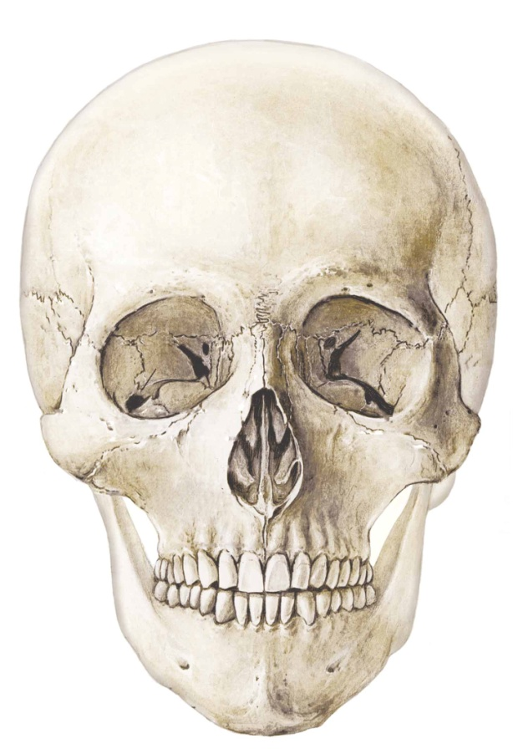
b) Facial Bones
Lacrimal Bone
Nasal Bone
Zygomatic Bone
Maxilla Bone
Mandible Bone

Slide 44
Facial Bones
Often broken in contact sports due to rough impact
Some fractures of the maxilla (upper jaw) can leave the lower face separated from the upper face

Slide 45
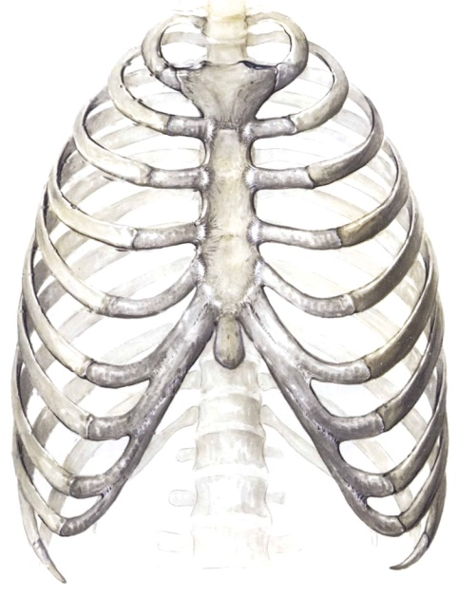
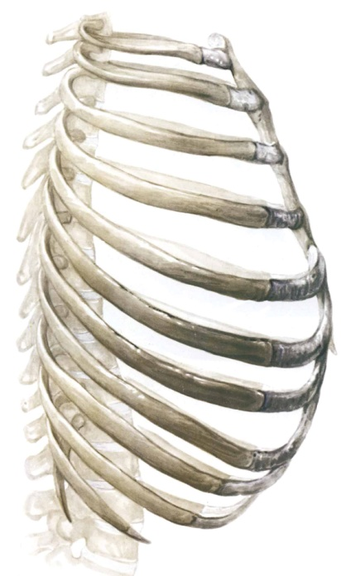
Ribs
Twelve pairs
Made up of :
Bone
Cartilage, which strengthens the chest cage and permits expansion
Curved and slightly twisted, making them ideal for protecting the chest area

Slide 46
Ribs
All 12 pairs of ribs articulate with the thoracic vertebrae posteriorly and sternum anteriorly.
Classified into three groups based on anterior attachment:
True ribs
1-7
attach to both the vertebrae and the sternum
False ribs
8-10
attach only to the sternum indirectly, through 7th rib
Floating ribs
11 and 12
attach only to the vertebral column

Slide 47
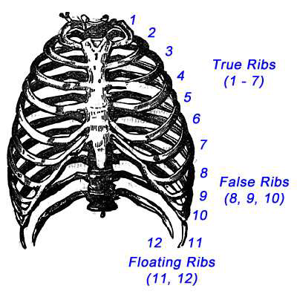
The Ribs
Sternum
Xiphoid Process

Slide 48
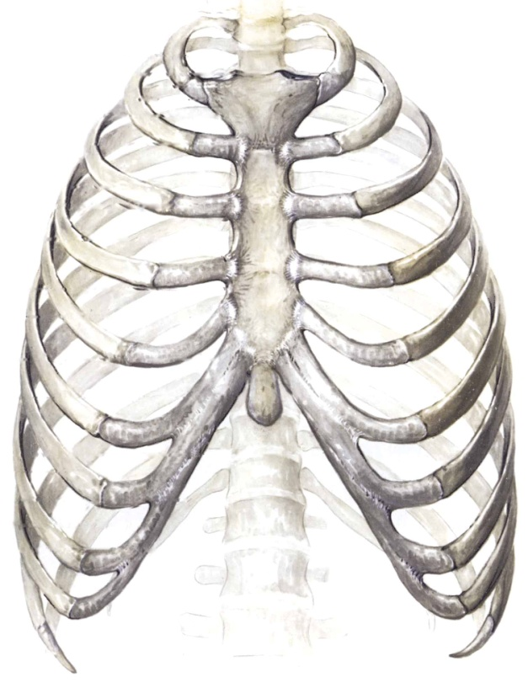
Sternum
Mid-line breast bone
The clavicles and ribs one to seven articulate with the sternum

Slide 49
Learning Outcomes
Everyone should:
Identify the appendicular skeleton
State the four types of bone.
Most
Distinguish anatomically between the axial and
appendicular skeleton
Draw and annotate the structure of a long bone.

Slide 50
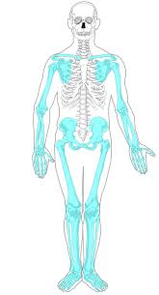
The Appendicular Skeleton
PAIRS ACTIVITY
Can you list all the bones in the appendicular skeleton?
Now color in the appendicular skeleton in your workbook

Slide 51
Appendicular skeleton
Consists of:
1. The pectoral girdle (chest)
2. The upper limb
3. Pelvic girdle (hip)
4. The lower limb

Slide 52
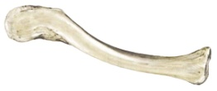
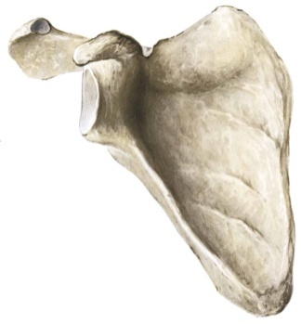
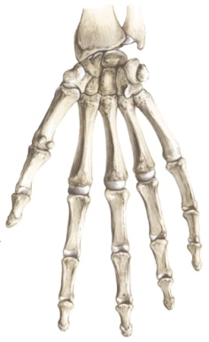
1.Pectoral Girdle
Consists of:
Scapula (shoulder blade)
Clavicle (collar bone)
Allows the upper limb great mobility
The sternoclavicular joint is the only point of attachment between the axial skeleton and the pectoral girdle

Slide 53
2. Upper Limb
Humerus
The arm bone
Shoulder to elbow
Radius and Ulna
The forearm bones
Elbow to wrist
Radius is located on the thumb side of the hand
When you pronate the forearm, the radius is actually crossing over the ulna – try it yourself

Slide 54
Upper Limb
Carpals
Metacarpals
Phalanges

Slide 55
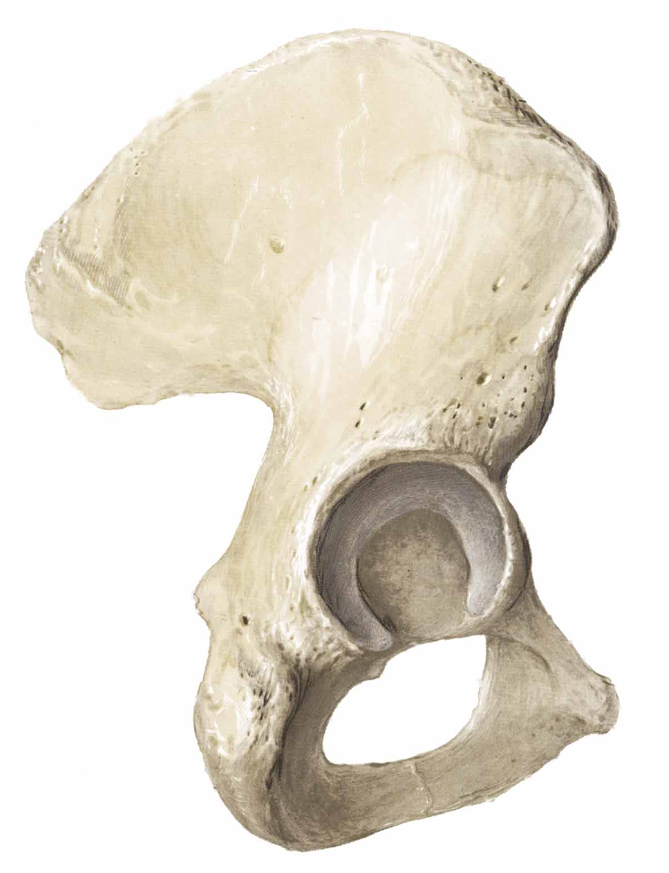
3. Pelvic Girdle
Made up of 3 bones fused together: ilium, ischium and pubis.
Supports the bladder and abdominal contents
Attachment:
Posteriorly – join with the sacrum
Anteriorly – join to each other
Laterally – join to the head of thigh bone (femur) in a cup-shaped acetabulum

Slide 56
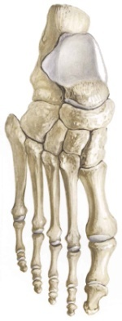
4. Lower Limb
Femur
Thigh bone
From hip to knee
Patella
Knee cap
Sesamoid bone in the tendon of the quadriceps (thigh) muscles

Slide 57
Lower Limb
Tibia and Fibula
Leg bones
From knee to ankle
Tibia is medial and fibula is lateral
Medial malleolus and Lateral malleolus
The distal ends of the tibia and fibula, respectively
Commonly referred to as the "ankle bones"
Can be easily palpated
Lateral
malleolus
Medial
malleolus

Slide 58
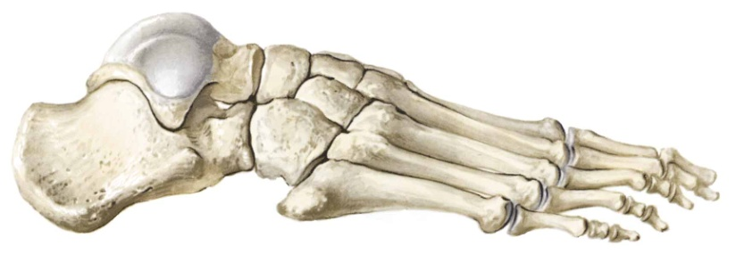
Lower Limb
Talus
Tarsals
Ankle bones
Calcaneus or heel bone
Talus
Metatarsals
5 bones of the foot
Unite with the toes
Phalanges
Toe bones
Three per toe, except the big toe – proximal, middle, and distal
Calcaneus
Tarsals
Metatarsals
Phalanges

Slide 59
http://www.softschools.com/science/human_body/skeletal_system/

Slide 60
Bone Shape
The shapes of the bones allow them to perform specific functions more effectively
The four main types of bones are long, short, flat and irregular.

Slide 61
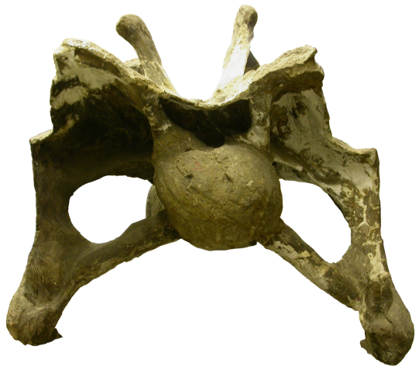
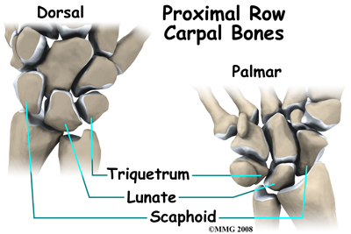
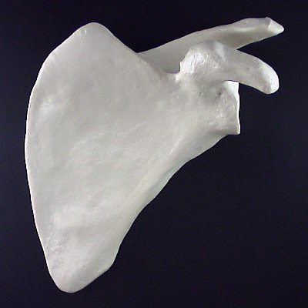
GROUP ACTIVITY-Match the picture with the name
Flat bone
Short bone
Irregular bone
Long bone
To articulate– form a joint

Slide 62
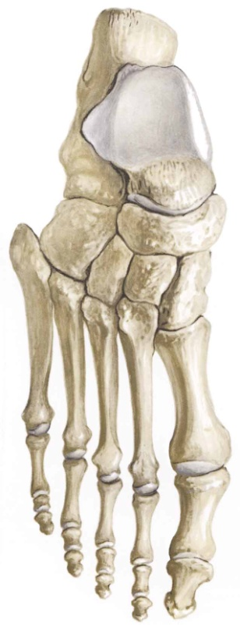
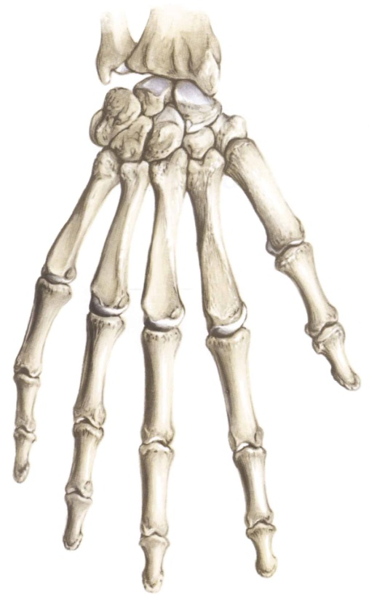
Short Bones:
Include bones of ankle (i.e., tarsals) and wrist (i.e., carpals)
– Serve as good shock absorbers
Carpals
Tarsals

Slide 63
Femur
Humerus
Long bones:
Include femur of the thigh, humerus of the upper arm, and others
Any bone whose length greatly exceeds its diameter
Provide levers for movement

Slide 64
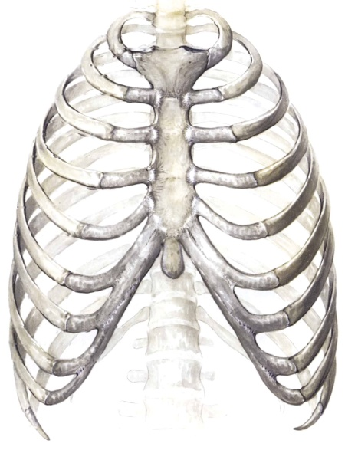
Flat bones:
Include bones of the skull, scapula, ribs, sternum, and clavicle
Largely protect underlying organs

Slide 65
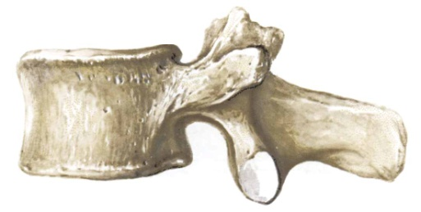
Irregular Bones:
Include bones of your face and vertebrae
Bones that cannot be placed in other groups
Fulfill special functions
Vertebrae
Facial bones

Slide 66
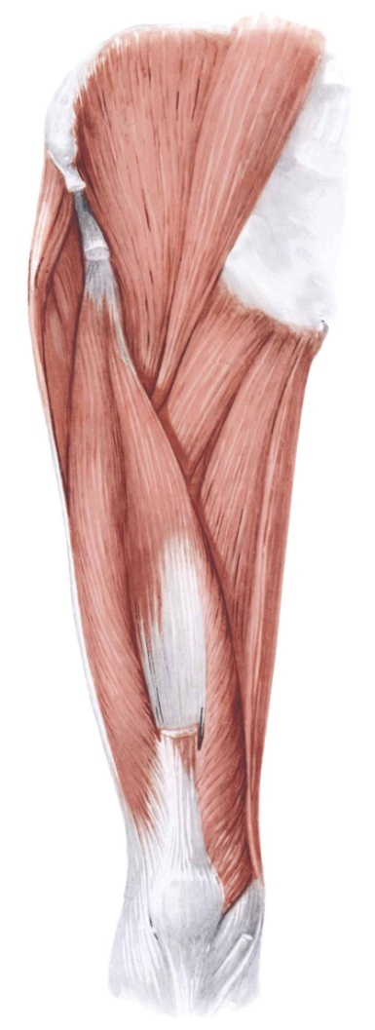
One other…
Sesamoid bones:
Includes the patella
Oval shape, like a pea, and found in tendons
Patella

Slide 67
Introduction to bone biology
What is the scientific name for a bone cell?
Why does bone need a blood supply?
What gives bone its flexibility and strength?

Slide 68
INDIVIDUAL TASK: Anatomy of a long bone colouring
Read the page fully and carefully
Highlight the functions of the different parts of the bones as you read through for the first time
Read through the page a second time, this time, follow the colouring instructions:
Colour code each structure (using bottom as legend)
Fill in the compact and spongy bone.
Fill in the medullary cavity and bone marrow.

Slide 69
Bone Composition
Cortical Bone
Bone is very strong for its relatively light weight
The major components of bone are:
Calcium carbonate
Calcium phosphate
Collagen
Water
Cancellous or spongy
bone. Where red bone
marrow is stored. Blood
cell production occurs
here.
Medullary (marrow) cavity.
Where yellow bone
marrow is stored.

Slide 70
Bone Composition
Mineral salts: Calcium carbonate and calcium phosphate:
Make up 60 to 70 percent of bone weight
Provide much of the bone’s stiffness and resistance to pressing or squeezing forces
Collagen (a protein):
Gives bone its characteristic flexibility and contributes to its ability to resist pulling and stretching forces
With aging, collagen is lost progressively and bone becomes more brittle.
Water
Bone consists of much smaller proportion of water than other body parts

Slide 71
Bone Classification
According to the degree of porosity, bone can be classified into two general categories:
Compact bone (low porosity)
Spongy or cancellous bone (high porosity)

Slide 72
 | Cancellous bone | Compact Bone
Porosity | High (Low mineral content and high collagen) | Low (High mineral content and low collagen)
Structure | Honey comb | Compact
Characteristic | Provides more flexibility but is not as stress resistant | Stiffer and can resist greater stress but less flexible
Function | Shock absorption due to its better ability to change shape are important | Withstanding stress in body areas that are subject to higher impact loads
Location | e.g., vertebrae | Long bones (e.g., bones of the arms and legs)

Slide 73
Effect of Fitness on Bone
When bones are subjected to regular physical activity and habitual loads, they tend to become more dense and more mineralized
E.g., Right forearm bones of right-handed tennis players are more dense than their left ones due to more frequent use
Inactivity works in the opposite direction, leading to a decrease in weight and strength.
E.g., Loss of bone mass has been noted in bed-ridden patients, inactive senior citizens, and astronauts

Slide 74
STARTER – Bone is a dynamic tissue
What does dynamic mean in this context?
How do our bones change over time?
Why does this happen?

Slide 75
Bone as a dynamic tissue
Read the Case Study in your workbook
In pairs, discuss possible answers to the questions in your workbook
Individually answer the questions in your workbook. Use full, meaningful sentences.

Slide 76
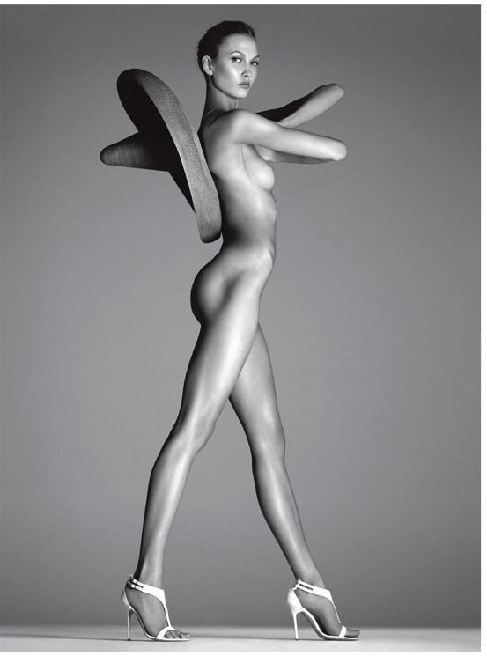
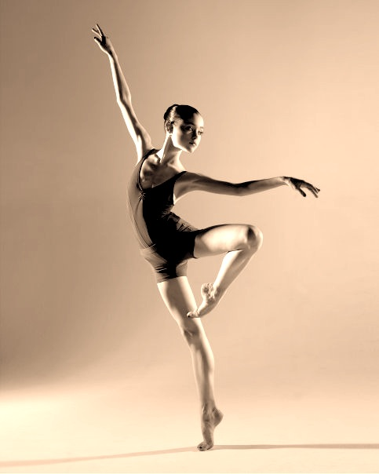
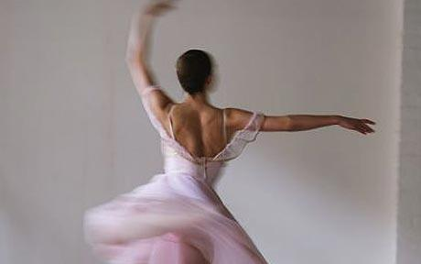
ToK in SEHS - Ballet
GROUP ACTIVITY – What words come to mind when you see these pictures?

Slide 77
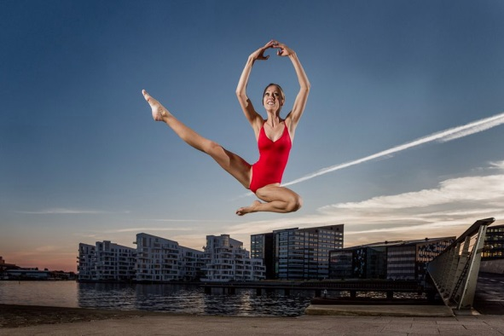
Buckhardt et al. 2011. “The effects of nutrition, puberty and dancing on bone density in adolescent ballet dancers.” Journal of Dance Medicine and Science. Vol 15 (2), Pp. 51-60.
16 years old – 60 asians and 67 caucasians – all females
Normal BMI in only 42.5% of dancers
15.7% had a more or less severe degree of thinness
Food intake below recommendation except animal proteins which was more than double the recommended amount
Individual Activity:
Read the BBC article in your workbook.
Group discussion:
Why is there a history of eating disorders within the ballet world?
How could you change the mindset of the dancers and the public in order to promote healthier eating?

