Slide 1
Joints
IB SEHS

Slide 2
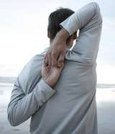
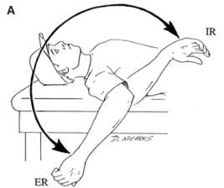
STARTER – flexion test to assess joint ROM at the shoulder
Shoulder – Inwards
Excellent – fingers overlap
Good – fingers touch
Average – fingers <2in apart
Poor – fingers >2in apart
Shoulder – Outwards
Lie on your back
Move right arm to the side at shoulder level
Bend elbow keeping upper arm in contact with the floor.
Allow hand and forearm to fall towards the floor in both directions.
Normal – forearm flat to floor in both directions.

Slide 3
Key Terms
Term | Definition
Joint | the physical point of connection between two bones. the point at which two or more bones articulate
Ligament | connect bone to bone and help to stabilize joints they surround. comprised mostly of long, stringy collagen fibers that create bands of tough, fibrous connective tissue slightly elastic so they can be stretched and gradually lengthen. when overstretched may compromise joint integrity.
Tendon | tough, flexible bands of fibrous tissue that attach skeletal muscle to bone.
To Articulate | to form a joint

Slide 4
Introduction to Joints
A joint is an articulation where two or more bones come in contact with one another.
Strands of connective tissue and ligaments hold the bones together and ensure stability.
Joint movement is linked to joint stability
More movement = Less stability
More stability = Less movement

Slide 5
Factors Affecting Joint Stability
The shape of the bones and whether they interlock with each other or not.
The area over which the bones are in contact.
The flexibility of the ligaments.
The influence of other soft tissue structures (muscles, tendons, etc).

Slide 6
Hip vs. Shoulder Compare and contrast based on stability and mobility. Be able to explain.

Slide 7
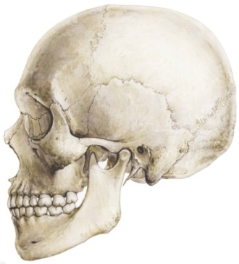
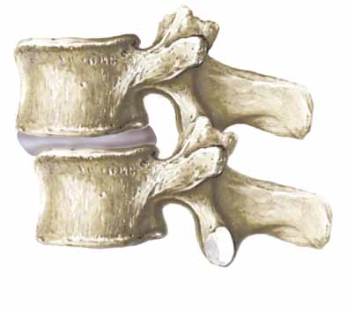
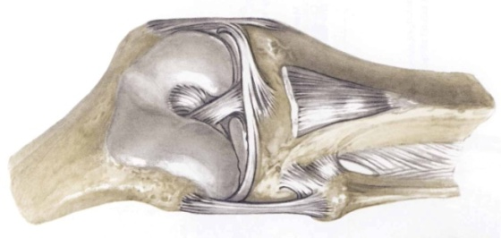
Types of Joints
Joint Type | Description | Example
Fibrous | Thin layer of fibrous tissue connecting the edges of two bones. Continuous with periosteum No movement allowed at these joints.
Cartilaginous | Bones separated by fibrocartilage discs or thick layer of hyaline cartilage. Limited movement allowed.
Synovial | Most commonly occurring joints. Most important for mobility.

Slide 8
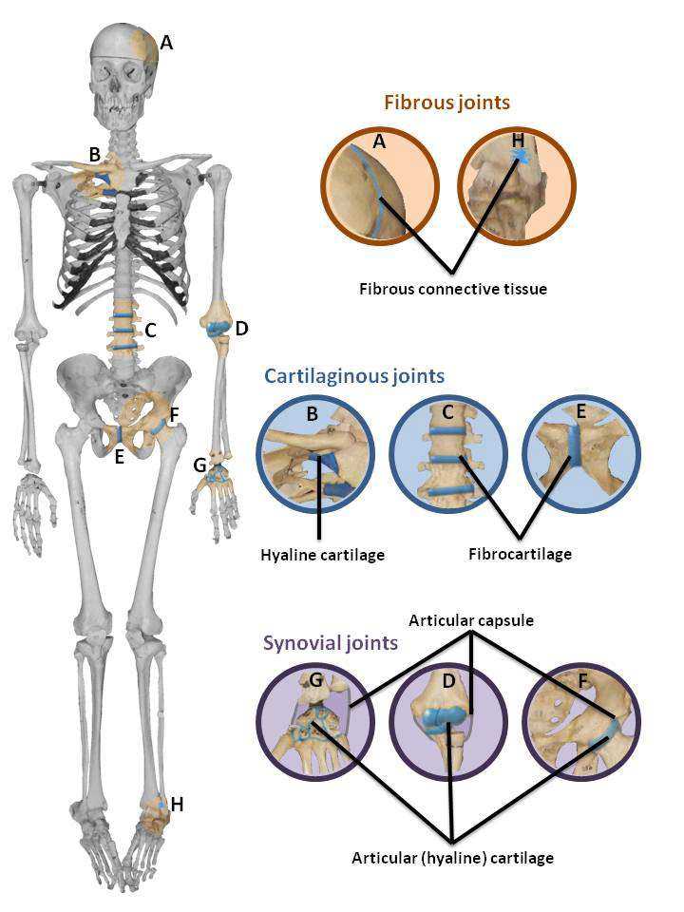

Slide 9
Characteristics of Synovial Joints
Joint cavity
Space between bones
Synovial membrane
Covers joint cavity, except over the surfaces of the articular cartilage
Secretes the lubrication fluid (synovial fluid)
Joint Capsule
May or may not have thickenings called intrinsic ligaments
Ligament
Support the joint and connect the articulating bones of the joint
Tendon
Attaches muscle to bone
Articular Cartilage
Smooth white layer that covers the articulating surface of bones
Reduces friction, absorbs shock, and protects bone

Slide 10
Sometimes present...
Fibrocartilage – menisci
Semi-lunar discs that help bones fit together more tightly
Also helps with cushioning and stability
Hyaline cartilage
A protective layer of dense white connective tissue that covers the ends of the articulating bones

Slide 11
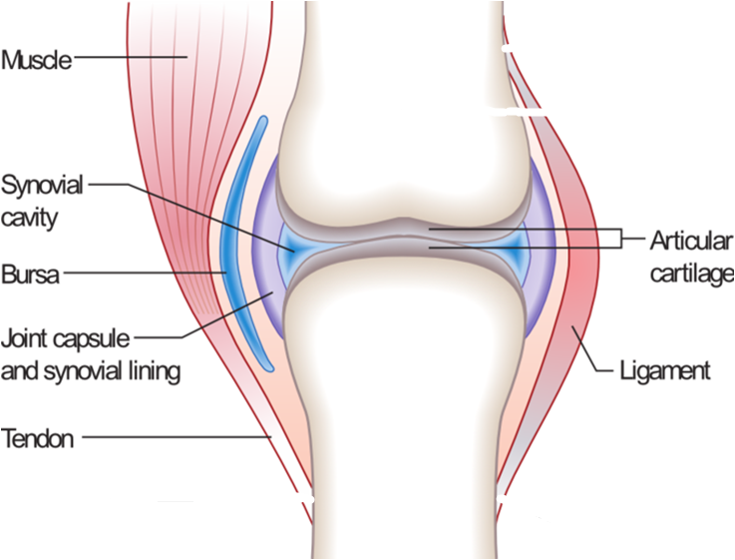
Structure of a Synovial Joint

Slide 12
The Knee

Slide 13
The Bone Song
http://www.youtube.com/watch?v=a0E5Nckxu5g

Slide 14
Types of Joints
Synovial joints are further classified into:
1. Hinge Joint
2. Pivot Joint
3. Condyloid Joint
4. Saddle-shaped joint
5. Ball and Socket Joint
6. Gliding Joint

Slide 15
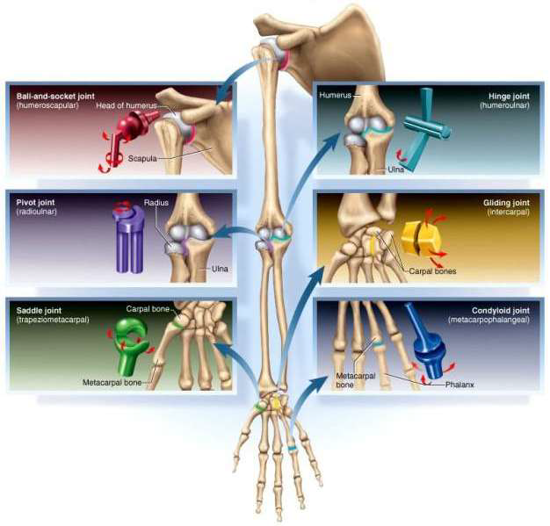

Slide 16
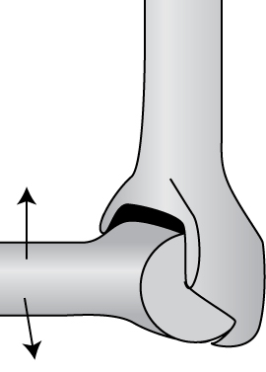
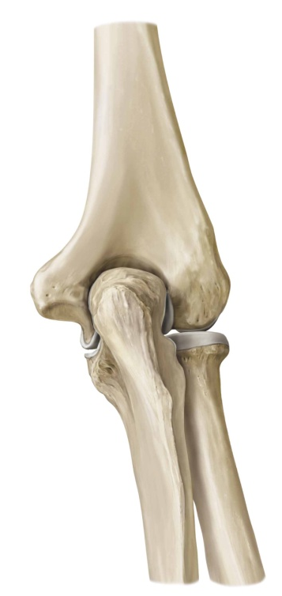
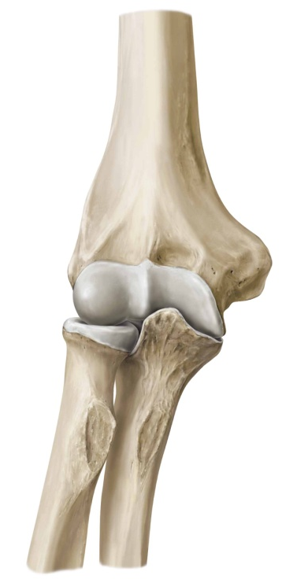
1. Hinge Joint
Uniaxial – movement one direction
Bend (flex) or straighten (extend) in one direction only
Has one articulating surface that is convex, and another that is concave
E.g., humero-ulnar elbow joint, interphalangeal joint

Slide 17
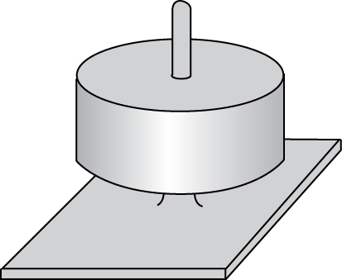
Pivot Joint
Uniaxial
One bone rotates around one axis
E.g., head of radius rotating against ulna

Slide 18
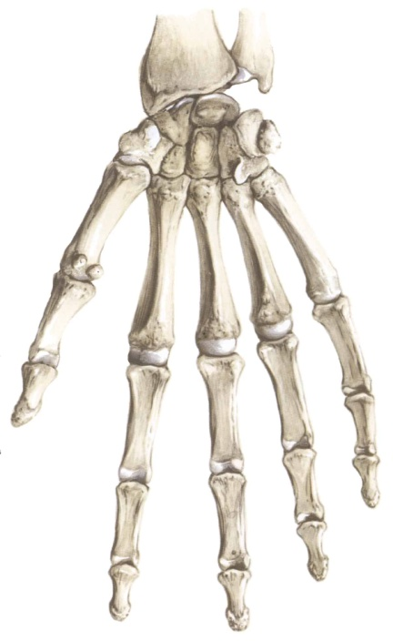
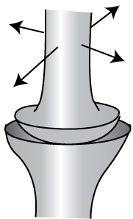
Condyloid (Knuckle) Joint
Biaxial – can move in two directions (flexion-extension, abduction-adduction)
The joint surfaces are usually oval
One joint surface is an ovular convex shape, and the other is a reciprocally shaped concave surface
E.g., metacarpophalangeal joint

Slide 19
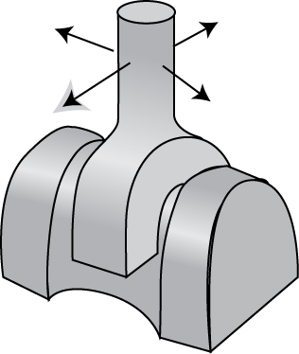
Saddle Joint
Biaxial (flexion-extension, abduction-adduction)
The bones set together as in sitting on a horse
E.g., carpometacarpal joint of the thumb

Slide 20
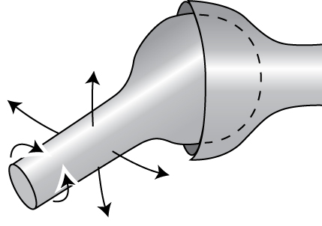
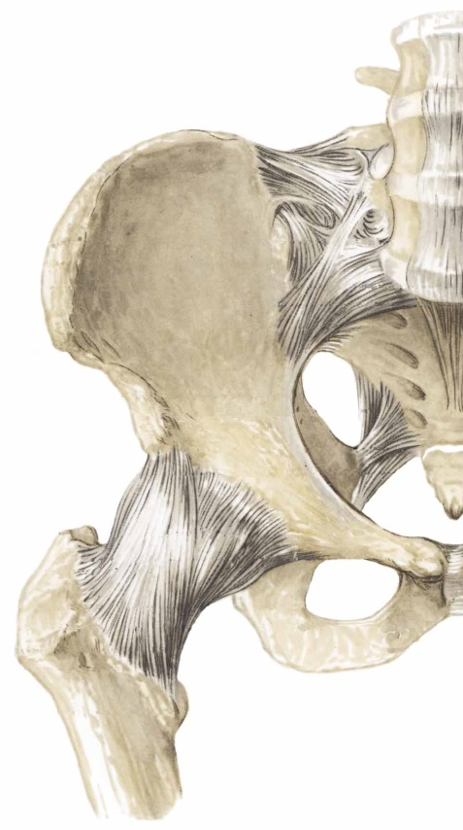
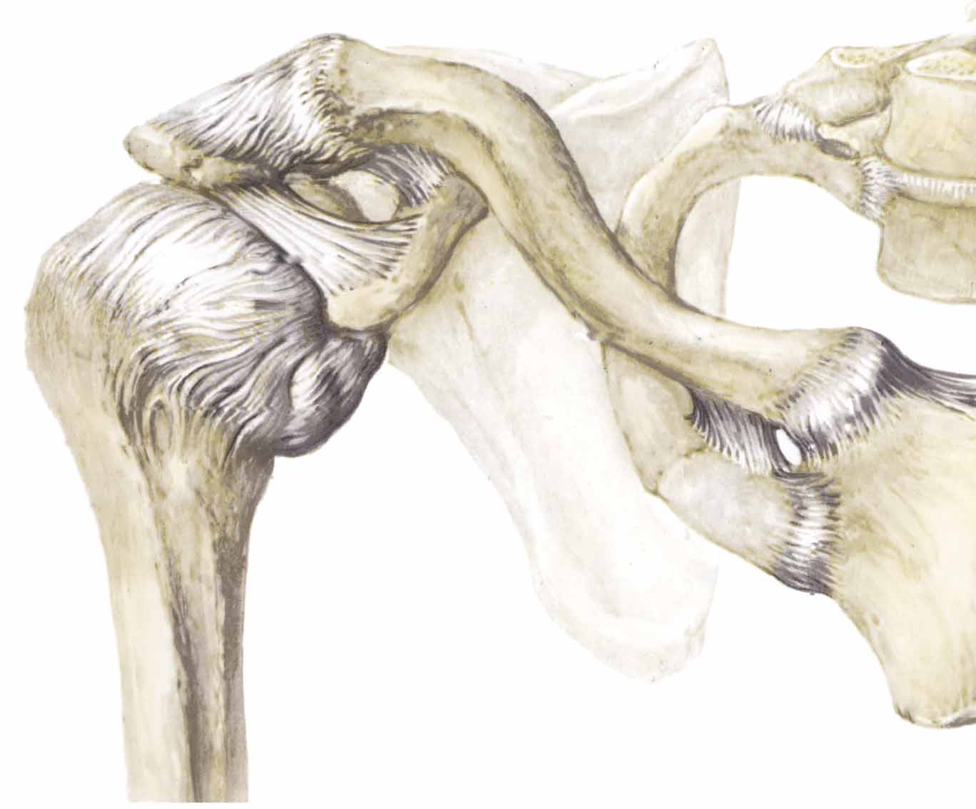
Ball and Socket Joint
Multiaxial (rotation in all planes)
Has the greatest amount of movement
A rounded bone is fitted into a cup-like receptacle
E.g., shoulder and hip joints

Slide 21
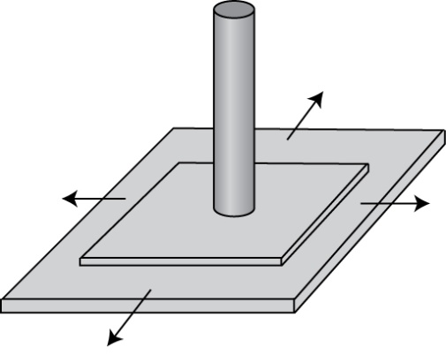
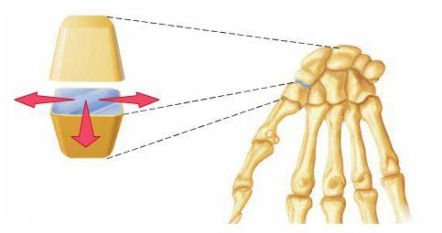
Gliding Joint
Uniaxial (permits gliding movements)
Has the least amount of movement
The bone surfaces involved are nearly flat
E.g., intercarpal joints and acromioclavicular joint

Slide 22
Partner Activity!
Movement at Synovial Joints:
Explain the movements occurring at each synovial joint during 4 different types of physical activities.

