Slide 1
Muscles
Topic 1: Anatomy

Slide 2
Starter – Group Activity
Decide whether the following statements are true or false:
There are over 1,000 muscles in the human body.
Skeletal, or voluntary, muscles are the ones you can control.
Ligaments connect muscle to bone.
Your heart is a muscle.
A muscle gets strained when it is stretched too much.
A sprain happens when a tendon is stretched too much.
Muscles that are not used can get smaller and weaker
If something hurts during sport you should play through the pain and it will go away.

Slide 3
Answers
There are over 1,000 muscles in the human body.
  False. There are over 600
Skeletal, or voluntary, muscles are the ones you can control.
  True. You can control your skeletal muscle
Ligaments connect muscle to bone.
  False. Ligaments connect bones to other bones.
Your heart is a muscle.
  True. The heart is “cardiac muscle”
A muscle gets strained when it is stretched too much.
  True. This can happen when not properly warm or during over-exertion.
A sprain happens when a tendon is stretched too much.
  False. Sprains occur in ligaments. STRAINS occur in tendons
Muscles that are not used can get smaller and weaker
  True. This is known as atrophy.
If something hurts during sport you should play through the pain and it will go away.
  False. If something hurts, stop or slow down and you may need to get it checked out.

Slide 4
Muscles Introduction
There are over 600 muscles in the human body.
They allow us to move and vary in size, shape and structure.
Muscles make up about 40-50% of the weight of the body.

Slide 5
Types of Muscle
Skeletal Muscle
  Used to move the skeleton
  Voluntary control
  Striated appearance
Cardiac Muscle
  Line the walls of the heart
  Involuntary control
  Striated appearance
Smooth Muscle
  Line the walls of blood vessels and hollow organs
  Involuntary control
  Not striated
Striated: appearance of light and dark stripes

Slide 6
Now complete the ‘types of muscles’ section in your workbook!

Slide 7
What do we use our muscles for???
Joint Movement
Movement of substances in our body (ex. Food, feces, blood)
To stabilize the skeleton
Generate body heat

Slide 8
Properties of Muscle Tissue
Contractility – the ability of muscles to contract and generate force
Extensibility – the ability of muscle to be stretched beyond its normal resting length
Elasticity – the ability to return to its original resting length after the stretch is removed.

Slide 9
Class Thought
Why do you warm up before playing sports?

Slide 10
Individual Activity
Write your signature 3 times under the heading normal.
Hold a handful of ice in your writing hand for 2 minutes.
Write your signature 3 times under the heading cold.
Place hands under warm running water for 2 minutes and massage your hands.
Write your signature 3 times under the heading warm.
FOR HOMEWORK:
Carry out the investigation in your workbook.
Complete the analysis questions for tomorrow.

Slide 11
Which muscles do you already know?

Slide 12
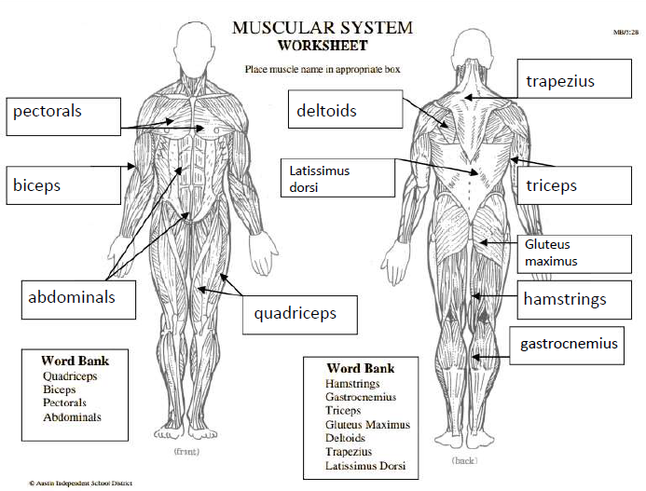
Which muscles do you already know?

Slide 13
Origin and Insertion of Muscles
Two attachment points for muscles:
  Origin is usually the more proximal attachment (closest to the center of the body). This is the bone that usually stays fixed.
  Insertion is usually the more distal attachment (furthest from the center of the body). This is usually the moveable bone.

Slide 14
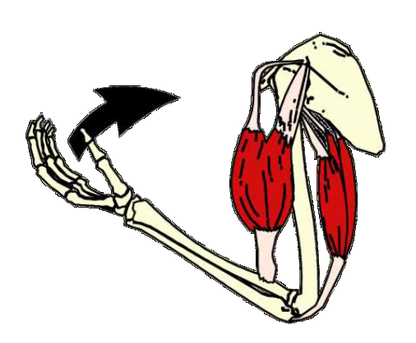
Example: Bicep Curl
Origin
The arm is being flexed.
The radius and ulna are the moving bones (insertion)
The humerus and scapula are stationary (origin)
Insertion

Slide 15
Now label the
diagram in your
workbook!

Slide 16
How Muscles Work
Skeletal muscles work across a joint and are attached to bones by strong cords known as tendons.
Most muscles work in pairs. As one muscle contracts, the other relaxes to allow the movement to take place.
Muscles have to work together because a muscle can only pull on a bone, it cannot push the bone back to its original position – the other muscle in the pairing is responsible for this.

Slide 17
Example: Biceps Brachii and Triceps Brachii
Agonist
Antagonist

Slide 18
How Muscles Work
The muscle doing the work (contracting) and creating the movement is called the agonist.
The muscle which is relaxing and letting the movement take place is called the antagonist.
Supporting muscles that aid the agonist are called synergists.
Muscles that stabilize other parts of the body during movement are called fixators or stabilizers.

Slide 19
Muscles of the Trunk
Important role in stability
Anterior muscles include the:
  rectus abdominus and
  external obliques.
The main posterior muscle is the:
  erector spinae.

Slide 20
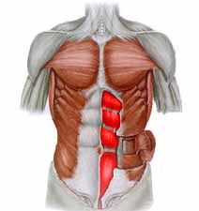
Rectus Abdominis
Paired midline muscles
Powerful flexor of the anterior abdominal wall
Strengthening of the abdominal muscles is a very important part of back therapy, because the abdominals act to support the back
Origin: pubis
Insertion: 5th -7th ribs and sternum
Rectus Abdominis

Slide 21
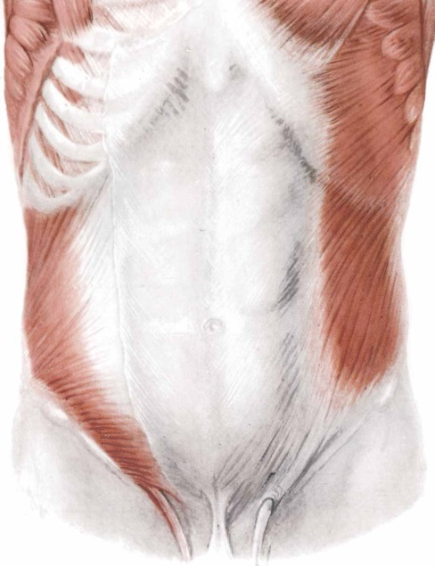
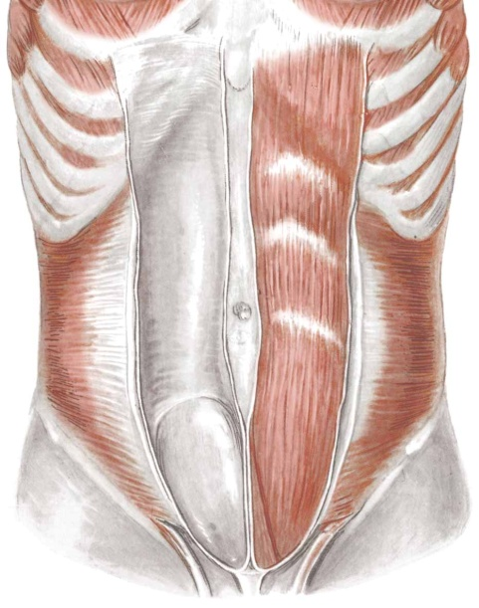
External Oblique
Origin: lower eight ribs
Insertion: ilium
Functions:
  Lateral bending of the abdomen
  Rotation of the abdomen
  Extension of the abdomen during forced inspiration
  Allow the development of a pregnant uterus
  Contract to help expel fecal contents from the rectum
External oblique

Slide 22
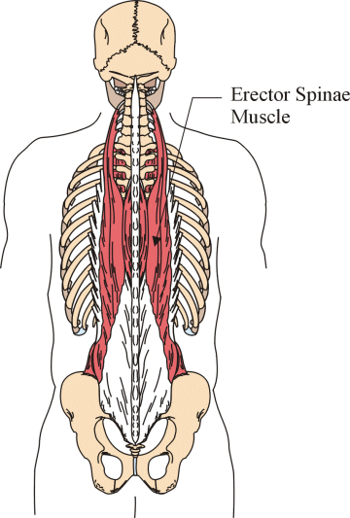
Erector spinae muscles
Important posterior neck muscles
Origin: ribs, cervical, thoracic and lumbar vertebrae, ilium
Insertion: ribs, cervical, thoracic and lumbar vertebrae
Maintain your erect position
  Also called anti-gravity muscles
  When someone faints, these muscle no longer function and the body falls face forward to the ground

Slide 23
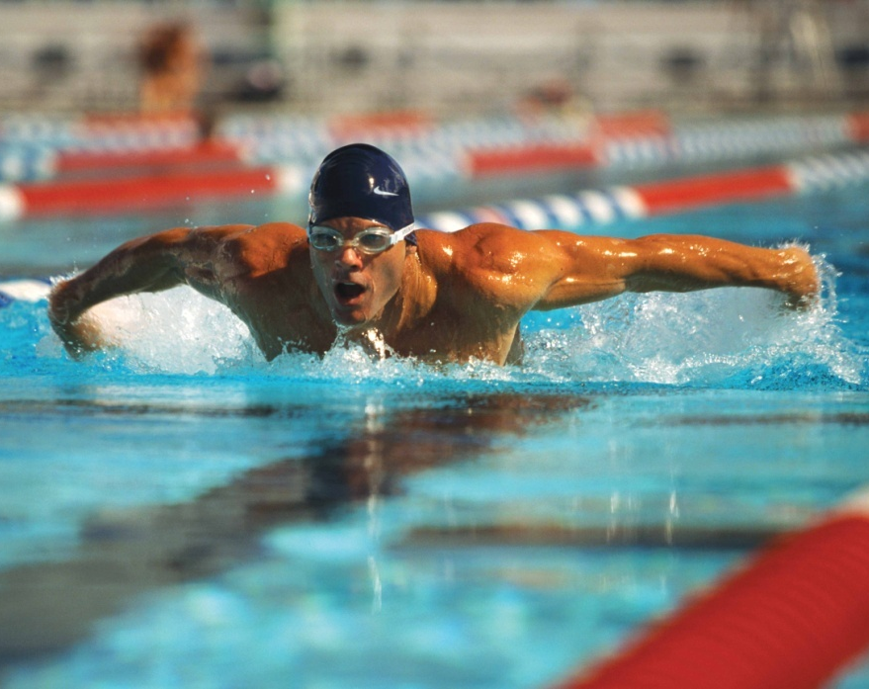
Muscles of the Upper Extremity
Anterior muscles:
- deltoid
- pectoralis major
- biceps brachii
Posterior muscles:
- trapezius
- latissimus dorsi
- triceps brachii

Slide 24
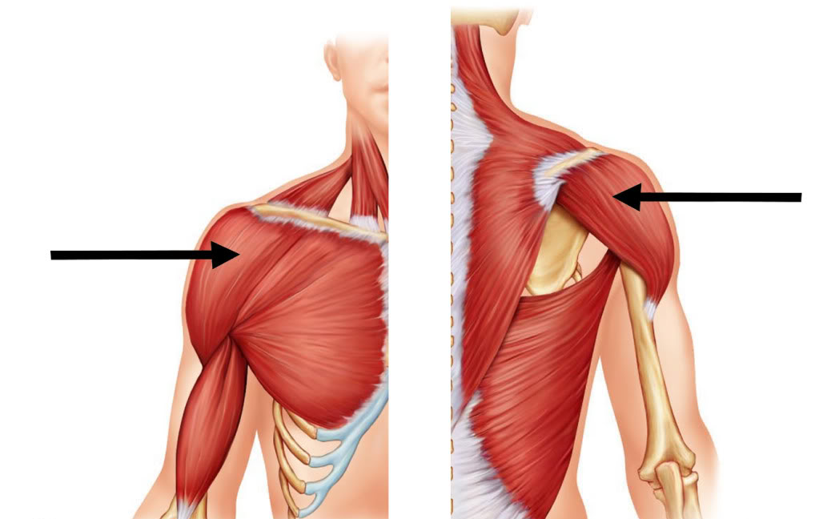
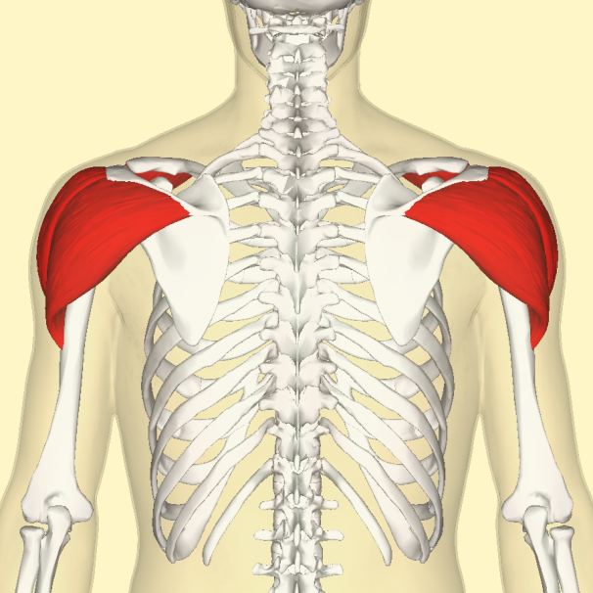
Deltoid
Deltoid – posterior view
Deltoid – anterior view
Origin: scapula, clavicle
Insertion: lateral humerus
Since the fibers run across the joint in several directions it is involved in most shoulder movements.

Slide 25
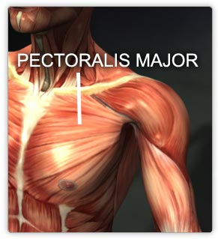
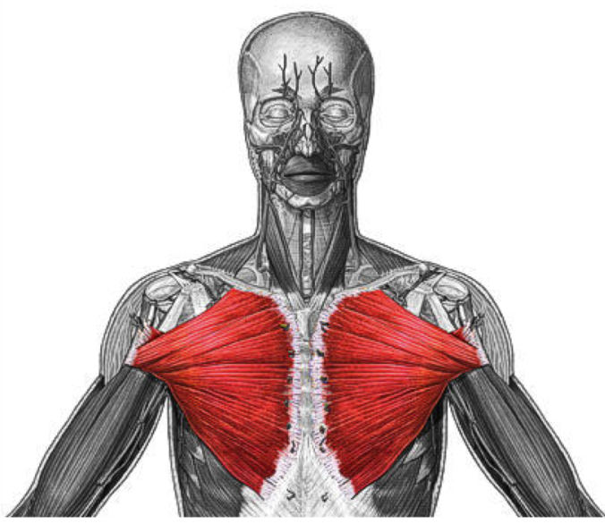
Pectoralis Major
Origin: sternum, clavicle, anterior ribs
Insertion: lateral humerus
Involved in all shoulder movements where the arm is brought forwards and upwards.

Slide 26
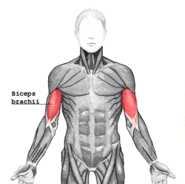
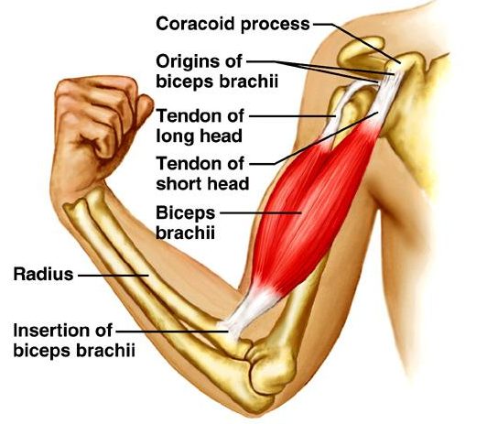
Biceps Brachii
Has two heads (hence bi-ceps)
Origin: Scapula
Insertion: radius
Crosses two joints – it is involved in both shoulder and elbow movement. It flexes (bends) the arm upwards at the shoulder and flexes (bends) the elbow.
Also supinates the forearm

Slide 27
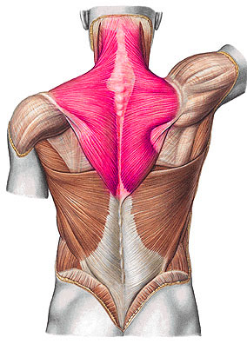
Trapezius
Location: posterior neck and upper back
Important lateral neck muscles
Origin: base of the skull, cervical and thoracic vertebrae
Insertion: clavicle, scapula
Movements:
  Acting alone, tilt the head to the one side
  Raise the shoulders

Slide 28
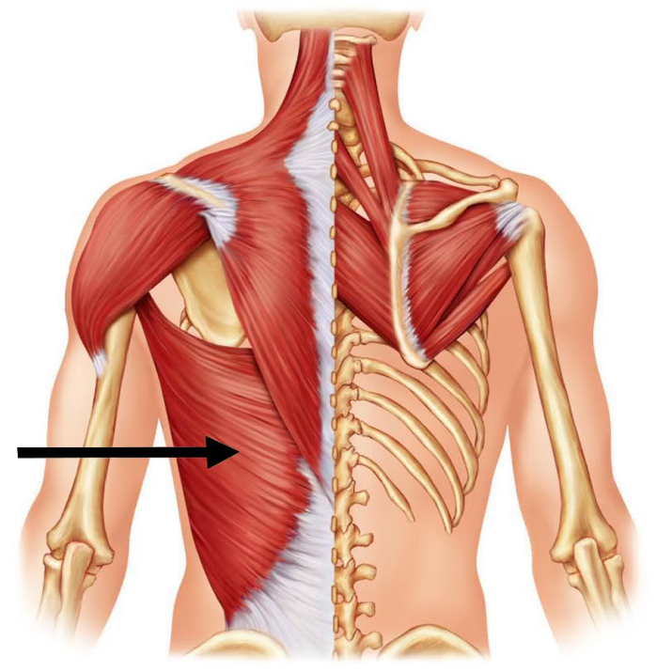
Latissimus Dorsi
Brings the arm backwards and rotates the arm inwards
Origin: sacrum, ilium, thoracic and lumbar vertebrae
Insertion: humerus
Good for rowing and swimming

Slide 29
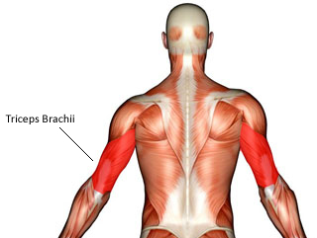
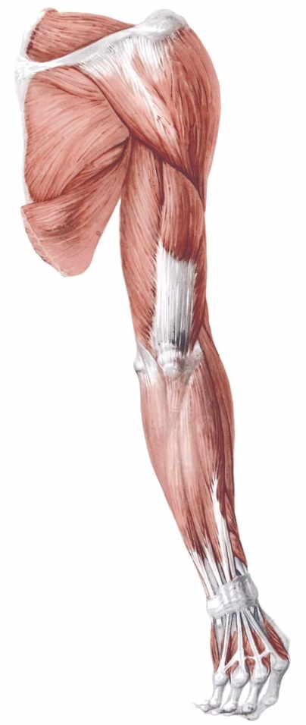
Triceps Brachii
Located on the posterior upper arm
Origin: scapula, humerus (has three heads)
Insertion: ulna
Helps move the arm backwards and straightens the elbow
Triceps

Slide 30
Muscles of Lower Extremity
Generally bigger than the upper extremity muscles.
They bear the weight of the entire body and forcefully push off the ground to move forwards and upwards when walking.

Slide 31
Muscles of the Lower Extremity
Anterior Muscles
- iliopsoas
- sartorius
- quadriceps
- tibialis anterior
Posterior Muscles
- gluteus maximus
- hamstrings
- gastrocnemius
- soleus

Slide 32
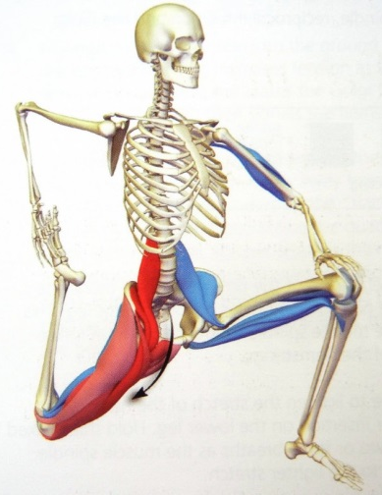
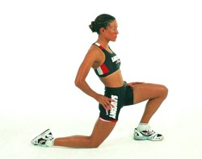
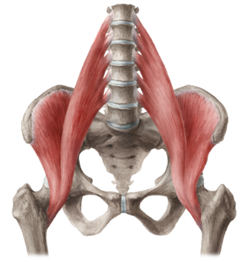
Iliopsoas
Deep muscle
Important for standing, walking & running
Hip flexor
Origin: lumbar vertebrae, ilium
Insertion: inner femur

Slide 33
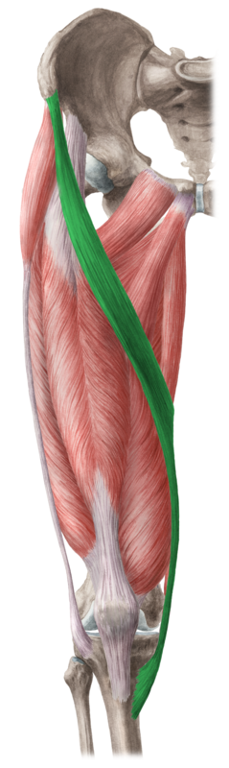
Sartorius
Origin: ilium
Insertion: medial tibia
Longest muscle in the body
  Used to sit cross-legged
Primary knee extensors
Sartorius and Rectus femoris also aid in flexion of the hip

Slide 34
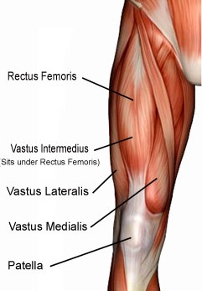
Quadriceps
4 muscles used to straighten the knee joint.
Important for jumping and kicking
Muscle | Origin | Insertion
Rectus femoris | Ilium | All four the same
Vastus lateralis | Femur | patella and
Vastus intermedius | Femur | upper tibia
Vastus medialis | Femur | “ “

Slide 35
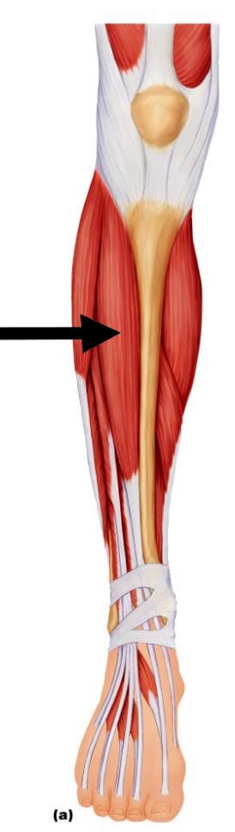
Tibialis anterior
Located front of leg
Origin: lateral tibia
Insertion: first metatarsal
Pulls toes towards the shins
Used in walking and running

Slide 36
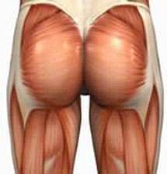
Gluteus Maximus
Largest of the three buttock muscles
Moves thigh backwards and principal extensor of the hip
Origin: posterior ilium, sacrum and coccyx
Insertion: lateral femur
Gluteus Maximus

Slide 37
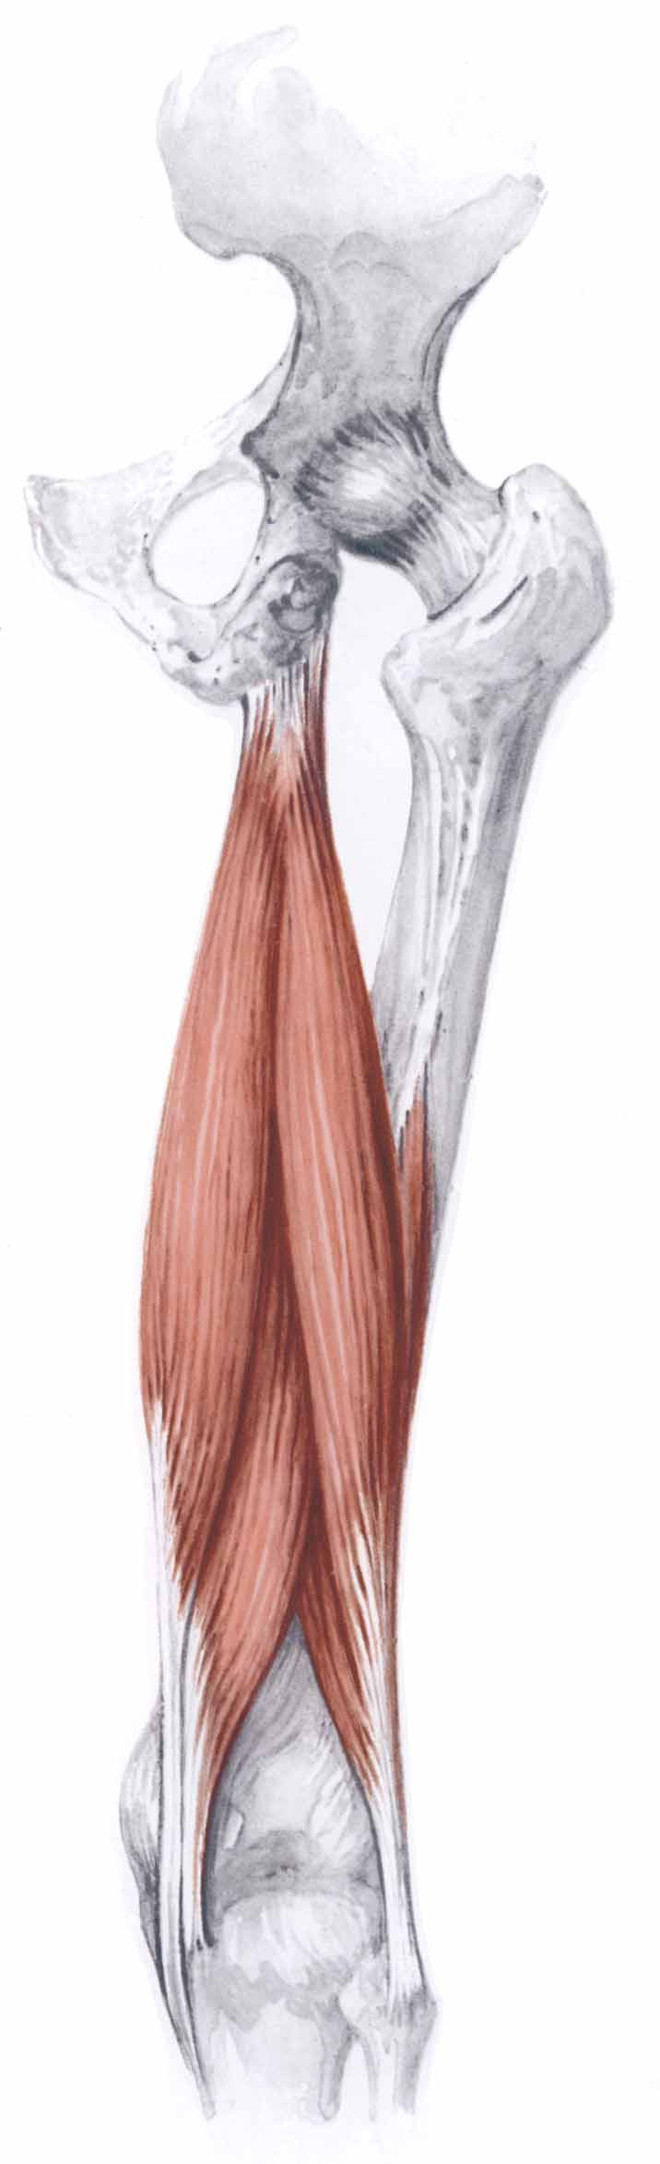
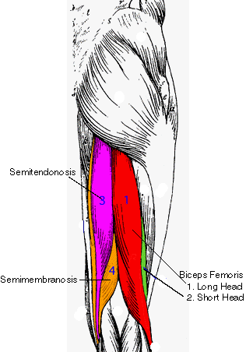
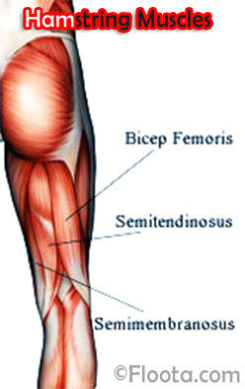
Hamstring group - 3 muscles
Primary flexors of the knee
Also extend the hip
Powerfully used when running and kicking
Long Head
of Biceps Femoris
Short Head
of Biceps Femoris
Semitendinosus
Semimembranosus

Slide 38
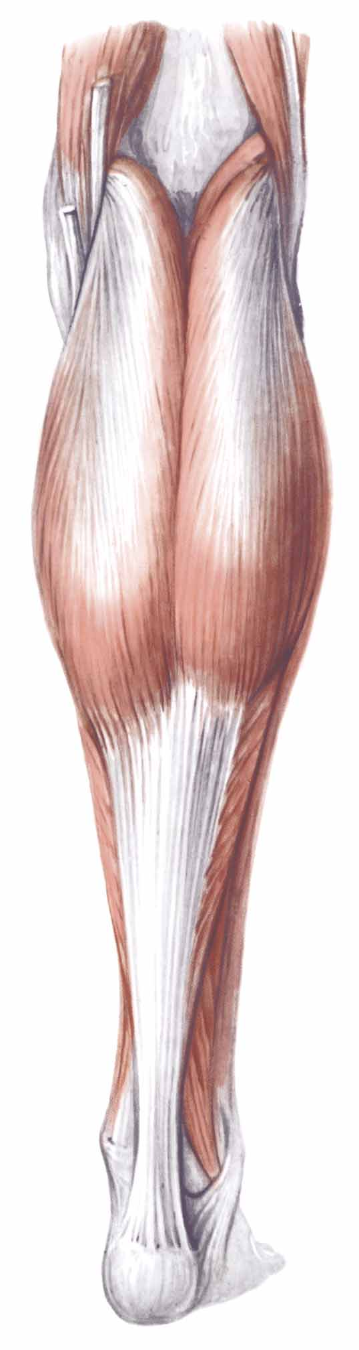
Two main muscles in the calf
Gastrocnemius
- most superficial and most prominent
- has two proximal heads
- Origin: posterior femur
- Insertion: calcaneus (via achilles tendon)
Soleus
- Origin: posterior tibia and fibula
-Insertion: calcaneus via achilles tendon
Principal plantar flexors of the ankle
Gastrocnemius
Soleus
Achilles Tendon

Slide 39
Structure of Skeletal Muscle
Fascia is a type of connective tissue that is located in-between and surrounding other tissues of the body such as muscles and bones.
Fascia is made up of fibrous tissue, adipose tissue, and fluid

Slide 40
3 Layers of Fascia in Skeletal Muscle
Epimysium
  Outer layer surrounding entire muscle.
  Tendons are continuation of the epimysium
Perimysium
  Surrounds each bundle of muscle fibers or fascicles
Endomysium
  Surrounds the individual muscle fibers

Slide 41
Structure of Skeletal Muscle
Muscle is surrounded by a membrane called the epimysium which comes together at the attachment point to form the tendon.
The “muscle belly” is divided into bundles called fascicles which are surrounded by their own membrane called the perimysium.
Each fascicle is made up of individual muscle cells called muscle fibers which are surrounded by a membrane called the endomysium.

Slide 42
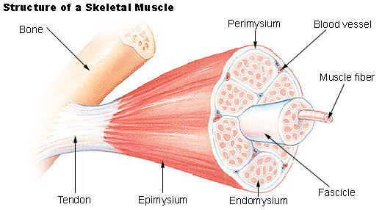
Structure of Skeletal Muscle

Slide 43
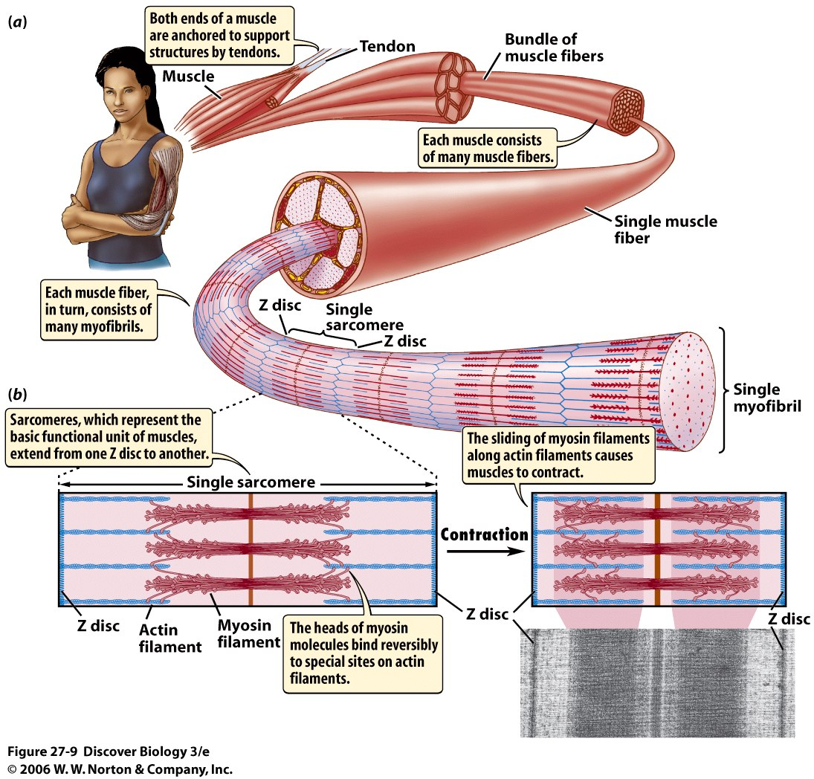

Slide 44
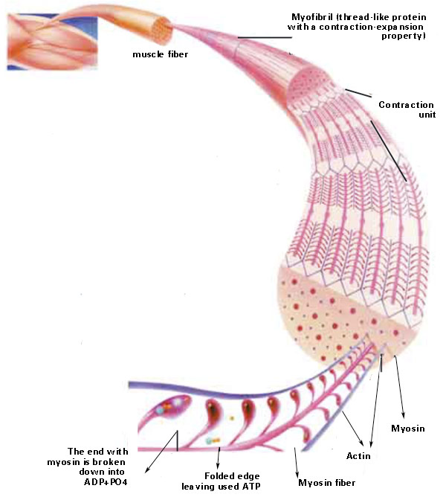
Sliding Filament Theory
…more in Ch. 4

Slide 45
Group Activity
Can you make a flow diagram to show the different levels of skeletal muscle structure?
Start with…skeletal muscle
End with… actin and myosin

Slide 46
Group Activity
Skeletal Muscle
Fascicle
Muscle Fiber
Myofibril
Sarcomere
Myofilaments
Actin and Myosin
Can you make a flow diagram to show the different levels of skeletal muscle structure?
Start with…skeletal muscle
End with… actin and myosin

Slide 47
Summary
Human anatomy deals with the structures that make up the human body (structure determines function)
The bones, joints, and muscles that make up the musculoskeletal system allow numerous movements to occur, with varying degrees of:
  Motion capabilities
  Strength
  Flexibility
Bones provide the structural framework necessary for support
Muscles supply the power
Joints supply the mechanism that allows human movement to occur

