Slide 1
Option D: Nutrition

Slide 2
D.1.1 Outline the features of the principal components of the digestive system.
The digestive system is made up of the digestive tract—a series of hollow organs joined in a long, twisting tube from the mouth to the anus—and other organs that help the body break down and absorb food.
Organs that make up the digestive tract are the
mouth,
esophagus,
stomach,
small intestine,
large intestine—also called the colon—
rectum, and anus.

Slide 4
Inside these hollow organs is a lining called the mucosa.
In the mouth, stomach, and small intestine, the mucosa contains tiny glands that produce juices to help digest food.
The digestive tract also contains a layer of smooth muscle that helps break down food and move it along the tract.

Slide 5
Two digestive organs, the liver and the pancreas, produce digestive juices that reach the intestine through small tubes called ducts.
The gallbladder stores the liver’s digestive juices until they are needed in the intestine.
Parts of the nervous and circulatory systems also play major roles in the digestive system.

Slide 6
Absorption and assimilation
Humans take in food into their digestive system through the mouth and the esophagus. However, this food is not truly inside the body until it has passed through a layer of cells into the body’s tissues. This happens in the small intestines and is called absorption.
Small finger like projectiles in the small intestine are called villus (villi – plural).
After food has been absorbed it is assimilated. It becomes part of the body’s tissues.

Slide 8
Relationship between structure of a villus and it’s function
Villi increase the surface area over which food is absorbed.
An epithelium, consisting of only one layer of cells is all that foods have to pass through to be absorbed.
Protrusions of the exposed part of the plasma membranes of the epithelium cells further increase the surface area for absorption. These projectiles are called microvilli.

Slide 9
Protein channels in the microvilli membranes allow rapid absorption of foods by facilitated diffusion and pumps allow rapid absorption by active transport.
Mitochondria in epithelium cells provide the ATP needed for active transport.
Blood capillaries inside the villus are very close to the epithelium so the distance from the diffusion of foods is very small.
A lacteal (a branch of the lymphatic system) in the centre of the villus carries away fats after absorption.

Slide 10
Stomach components include:
Lumen: hollow of the stomach
Rugae: Inner layer of expandable folds. Make the stomach very extendable, especially after a big meal.
Mucous coating: A mucous membrane lines the stomach which contains glands that secrete gastric juices, up to 3 liters daily.
Muscular contractions of the stomach physically grind the bolus (clumps of food) into smaller particles, called chyme, and regulate the release of chyme to the small intestines.

Slide 11
pH in the Mouth
D.1.2 State the typical pH values found throughout the digestive system.
pH plays a crucial role in a normally functioning digestive tract.
In the mouth, pharynx, and esophagus, pH is typically about 6.8, very weakly acidic.
Saliva controls pH in this region of the digestive tract.

Slide 12
pH in the Stomach
pH in the stomach is very acidic and inhibits the breakdown of carbohydrates while there. It has a pH of about 4.
The strong acid content of the stomach provides two benefits, both serving to breakdown proteins for further digestion in the small intestines, as well as providing non-specific immunity, retarding or eliminating various pathogens.

Slide 13
pH in the Small Intestines
In the small intestines, the duodenum provides critical pH balancing to activate digestive enzymes.
The liver secretes bile into the duodenum to neutralize the acidic conditions from the stomach.
Also the pancreatic duct empties into the duodenum, adding bicarbonate to neutralize the acidic chyme, thus creating a neutral environment.
The mucosal tissue of the small intestines is alkaline, creating a pH of about 8.5, thus enabling absorption in a mild alkaline in the environment.

Slide 14
pH and Digestive Enzymes
Salivary amylase is contained in saliva and starts the breakdown of carbohydrates into monosaccharides. Most digestive enzymes are sensitive to pH and will not function in a low-pH environment like the stomach. A pH below 7 indicates an acid, while a pH above 7 indicates a base; the concentration of the acid or base, however, does also play a role.

Slide 16
Movement of Food Through the System
The large, hollow organs of the digestive system contain muscle that enables their walls to move. The movement of organ walls can propel food and liquid and also can mix the contents within each organ.
Typical movement of the esophagus, stomach, and intestine is called peristalsis. The action of peristalsis looks like an ocean wave moving through the muscle.
The muscle of the organ produces a narrowing and then propels the narrowed portion slowly down the length of the organ. These waves of narrowing push the food and fluid in front of them through each hollow organ.

Slide 17
Summary
mouth—mechanical digestion and chemical digestion
esophagus—peristalsis action
stomach—rugae, lumen, mucous coating
small intestine—villi and microvilli increase area for absorption
large intestine—water balance, vitamin absorption
pancreas—production of enzymes
liver—production of bile
gall bladder—storage of bile.

Slide 18
D.1.3 Describe the function of enzymes in the context of macronutrient digestion.
Enzymes are protein molecules that increase the rate of reactions. Reactions in cells would be so slow without enzymes that animals and plants would not have sufficient energy for growth and maintenance.
They lower the activation energy i.e. the amount of energy needed for reaction to occur. The action of enzymes is influenced by several factors.
temperature
and pH,
and that each reaction requires a specific enzyme.

Slide 19
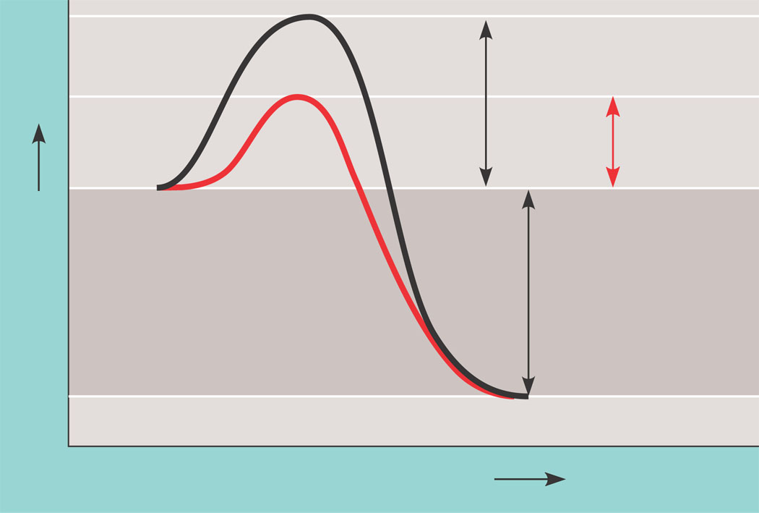
Enzymes enable reactant molecules to absorb enough energy to reach the transition state even at moderate temperatures.
Course of
reaction
without
enzyme
E_{A}
without
enzyme
E_{A} with
enzyme
is lower
Reactants
Free energy
Course of
reaction
with enzyme
∆G is unaffected
by enzyme
Products
Progress of the reaction

Slide 20
Enzyme and substrate(s) fit together like a lock and a key

Slide 21
Enzymes have an optimum pH at which they function best. At other pH’s, enzymes are denatured

Slide 22
D.1.4 Explain the need for enzymes in digestion
Due to the temperature of the body (37 degrees ) many of the reactions of digestion would not occur at a speed fast enough to supply the body with energy.
Enzymes allow the reactions to proceed faster.

Slide 23
D.1.5 List the enzymes that are responsible for the digestion of carbohydrates, fats and proteins from the mouth to the small intestine.
Carbohydrates: salivary amylase, pancreatic amylase
Fats: pancreatic lipase
Proteins: pepsin, trypsin

Slide 25
D.1.6 Describe the absorption of glucose, amino acids and fatty acids from the intestinal lumen to the capillary network.
Glucose, fatty acids and amino acids cross the brush-border membrane, pass through the cytosol of the absorptive cell and cross the basolateral membrane before entering the capillary network (glucose and amino acids) or the lymphatic system (fats).
Triglycerides (fats) are transported from the small intestine by the lymphatic system and eventually rejoins with the capillary network near the heart.

Slide 26
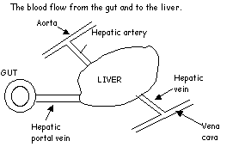
Absorption and Assimilation
Once food enters the epithelial cells of the villi in the small intestine it will pass into either the blood capillary network or into the lacteal.
Sugars and amino acids pass into the capillaries largely by active transport by the epithelial cells,
While fatty acids and glycerol pass into the lacteals where they recombine to form triglycerides (fats).

Slide 27
Absorption and Assimilation
Mouth.
Physical Digestion +Saliva Added
Chewed Food as Pulp
Stomach.
Gastric Juice and HCl added
Partially Digested Food as Liquid
Pancreatic Juice and Bile.
Small Intestine.
Nutrients Absorbed into Blood
Enzymes from Gut Wall.
Fully Digested Food.
Large Intestine.
H₂O and Salt Absorbed into Blood
Undigested Food and Other Waste.

Slide 28
D.2.1 State the reasons why humans cannot live without water for a prolonged period of time.
• is the basic substance for all metabolic processes in the body
• regulates body temperature(evaporation)
• enables transport of substances essential for growth (dissolved substances in blood and lymph)
• allows for the exchange of nutrients and metabolic end products.

Slide 29
Water is obtained from 3 sources:
Drinking
Water present in food
Bi-product of respiration

Slide 30
Water is lost in several ways:
From the lungs during exhalation
The skin and mouth during sweating
Lost in bodily fluids (Urine, Faeces, semen, milk)

Slide 31
D.2.2 State where extracellular fluid can be located throughout the body.
Extracellular fluid includes the
blood plasma and lymph,
saliva,
fluid in the eyes,
Fluid secreted by glands and the digestive tract,
Fluid surrounding the nerves and spinal cord and
fluid secreted from the skin and kidneys.
Intracellular is the fluid contained within a cell.

Slide 33
D.2.3 Compare water distribution in trained and untrained individuals.
Water comprises about 60-70% of a ‘normal’ person's body weight.
Because muscle tissue is 70-75% water, the body weights of lean, muscular athletes may exceed 70% water.
In contrast, fat tissue is only 10% water.

Slide 34
Effects of inadequate fluid intake
Inadequate fluid intake will have negative effects on the blood, brain, and muscle.
Essential functions of water for athletes include:
maintaining normal body temperature and
normal blood volume.
Because these functions are critical to survival as well as to athletic training and performance, athletes need to drink enough fluid throughout the day to replace water lost in sweat, respiration, urine, and feces.

Slide 35
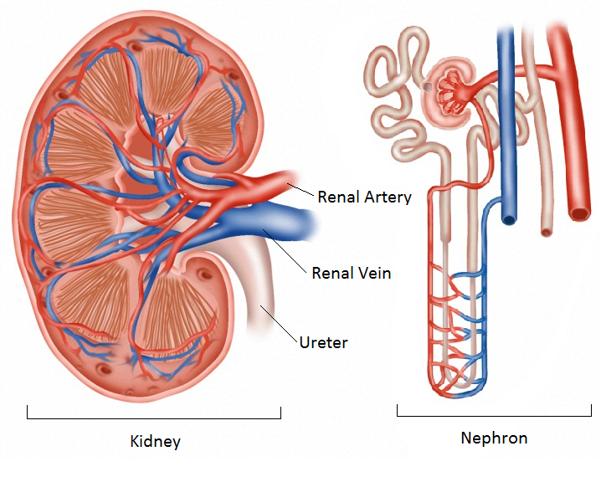
D.2.4 Annotate a diagram of a glomerulus and associated nephron.

Slide 36
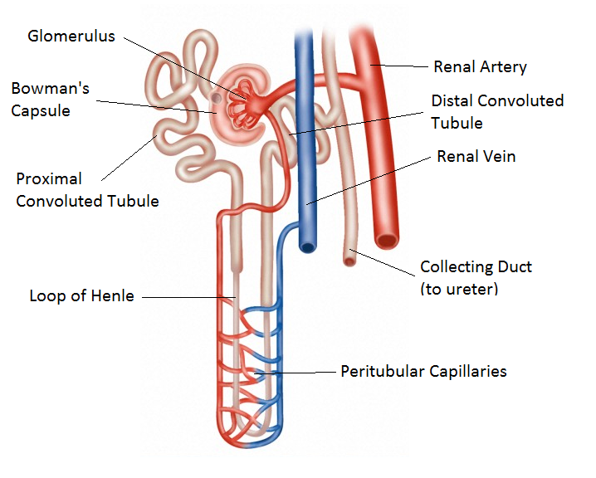
Nephron Diagram

Slide 37
Kidney Function
The kidney consists of about one million filtering units known as nephrons.
A large volume of water is filtered by the blood every hour.
Once this water passes into the kidney tubule. It can be regarded as being outside the body. If this water continues along the kidney tubule, it will eventually flow into the collecting tubules and then leave the kidney via the ureter as urine.
The urine will then flow into the bladder and be passed.

Slide 38
However, much of this water can be reabsorbed as it passes along the kidney tubule.
The amount reabsorbed will depend on how much water the body needs.
This is regulated by a hormone called ADH (Antidiuretic hormone).

Slide 40
D.2.5 Explain that homeostasis involves monitoring levels of variables and correcting changes in levels by negative feedback mechanisms.
Homeostasis is the maintenance of a constant environment.
If humans are to survive, it must be able to respond to changes in the environment so that the components of the internal environment stay within the tolerance limits.
To achieve this, both the nervous and hormonal systems must work in harmony.

Slide 41
Feedback mechanisms are essential for homeostasis.
In negative feedback systems, the response produced reduces the intensity of the original stimulus.
Stimulus Receptor Effector Response
Negative Feedback
(Response reduces intensity of original stimulus)

Slide 42
D.2.6 Explain the roles of the loop of Henlé, medulla, collecting duct and ADH in maintaining the water balance of the blood.
When body fluid levels are low, these changes are detected by receptors in the hypothalamus and it responds by doing 2 things:
Activates the sensation of thirst, increasing the desire to drink more fluid.
Secretes anti-diuretic hormone (ADH) which causes the kidneys to retain fluids and reduce urine production.

Slide 43
ADH and Kidney Function
When ADH is secreted it travels in the blood to the kidney where it stimulates the uptake of water by osmosis.
ADH causes the cells of the kidney tubules to become highly permeable to water.
Water then moves from the tubules into the surrounding medulla where it can be reabsorbed by the body via the peritubular capillaries.
If body fluids are sufficient then little ADH is released, resulting in excess water being passed in the urine.

Slide 44
ADH and Kidney Function
The wall of the descending loop is permeable to water but not electrolytes. Water is absorbed into the medulla (reduces volume).
The ascending loop is permeable to NaCl but not water. NaCl is removed from fluid (re-dilution).
In the collecting duct reabsorption of water occurs based on the amount of ADH present. This dictates final volume and concentration.

Slide 45
D.2.7 Describe how the hydration status of athletes can be monitored.
Consider urine colour,
Urine osmolarity and
Variation in body mass loss.

Slide 48
D.2.8 Explain why endurance athletes require a greater water intake.
The more energy an athlete expends, the greater are his fluid needs.
Heat is a byproduct of energy production, and excess heat must be transferred from the body to the environment to maintain normal body temperature.
Evaporation of sweat from the athlete's body is the primary way of dissipating excess heat.
Sweat loss varies among athletes and can exceed 1.5 liters per hour.

Slide 49
To maintain adequate hydration (euhydration), sweat loss must be replaced.
Consuming 1.0 to 1.5 ml of fluid for each kilocalorie that is expended is optimal.
Thus, an athlete who expends 5,000 calories a day needs 5,000 to 7,500 ml (5.0-7.5 L) of fluid intake a day to maintain fluid balance.
NOTE: Fluid consumption includes all liquids plus water in foods.

Slide 50
Higher levels of dehydration impair
mental concentration,
alertness,
muscular strength and endurance,
physical work capacity, and
increase risks for heat injury.
Deterioration in thermoregulatory and cardiovascular responses due to dehydration compromises athletic performance and can be life-threatening.

Slide 51
D.2.9 Discuss the regulation of electrolyte balance during acute and chronic exercise.
The level of any electrolyte in the blood can become too high or too low.
The main electrolytes in the blood are sodium, potassium, calcium, magnesium, chloride, phosphate, and carbonate.

Slide 52
Most commonly, problems occur when the level of sodium, potassium, or calcium is abnormal.
Often, electrolyte levels change when water levels in the body change.
For example, a low level of potassium is called hypokalemia, and a high level of sodium is called hypernatremia.

Slide 53
A low sodium level (hyponatremia) may result from not consuming enough sodium in the diet, excreting too much (in sweat or urine), or being overhydrated. The sodium level may decrease when a person drinks a lot of water without consuming enough salt (sodium chloride), typically during hot weather when a person also sweats more. The sodium level may decrease when large amounts of fluids that do not contain enough sodium are given intravenously.

Slide 54
The twin risks of hypohydration and hyponatremia can lead to morbid and even fatal outcomes if rational replacement regimens are not followed, especially in endurance athletes and during hot or humid conditions.
Replacement fluid should contain water, sodium, and perhaps potassium to avoid overhydration-induced hyponatremia. Carbohydrates are added if muscle exertion is to continue for prolonged periods (>60 minutes in duration).

Slide 55
Electrolytes are commonly found in sports drinks. In oral rehydration therapy, electrolyte drinks containing sodium and potassium salts replenish the body's water and electrolyte levels after dehydration caused by exercise, diaphoresis, diarrhea, vomiting, intoxication or starvation.

Slide 56
"It's really not necessary to replace losses of sodium, potassium and other electrolytes during exercise since you're unlikely to deplete your body's stores of these minerals during normal training. If, however, you find yourself exercising in extreme conditions over 3 or 5 hours (a marathon, Ironman or ultramarathon, for example) you may likely want to add a complex sports drink with electrolytes." (Elizabeth Quinn, trainer and health professional)^{[1]}
Athletes who do not consume electrolytes under these conditions risk overhydration (or hyponatremia).

Slide 57
Because sports drinks typically contain very high levels of sugar, they are not recommended for regular use by children. Water is considered the only essential beverage for children during exercise.
Medicinal rehydration sachets and drinks are available to replace the key electrolyte ions lost during diarrhea and other gastro-intestinal distresses. Dentists recommend that regular consumers of sports drinks observe precautions against tooth decay.

Slide 58
D.3.1 Define the term basal metabolic rate (BMR).
Basal metabolic rate (BMR) is the amount of energy expended while at rest in a neutrally temperate environment, in the post-absorptive state (meaning that the digestive system is inactive, which requires about twelve hours of fasting in humans).
The release of energy in this state is sufficient only for the functioning of the vital organs
www.bmi-calculator.net/bmr-calculator/

Slide 59
D.3.2 State the components of daily energy expenditure.
Limit to:
• basal metabolic rate
• thermic effect of physical activity
• thermic effect of feeding

Slide 60
D.3.3 Explain the relationship between energy expenditure and intake.
Energy Balance = Energy intake – Energy expenditure
An energy imbalance results in a change in the body mass.
This change in body mass is generally achieved over a long period of time (months / years)

Slide 61
D.3.4 Discuss the association between body composition and athletic performance.
Consider body composition from two
components, fat and fat-free mass. A
distinction between fat-free mass and lean
body mass should be made. The discussion
should include reference to typical levels of
body fat and consider the accuracy of body
fat measurements (see 6.1.7).

Slide 62
Two of the largest contributors to body mass have contrasting energy demands, so body composition is an important determinant of energy expenditure.
Adipose tissue (fat) has lower metabolic demand than other tissues such as fat free mass.
In adults there is often a decline in fat free mass and an increase in adipose tissue which accounts for a decrease in BMR with older age.

Slide 63
The BMR of an adult male will be about 1MJ/day higher than a female of the same body mass.
WHY???

Slide 65
Athletic performance is, to a large degree, dependent on the athlete's ability to sustain power (both anaerobically and aerobically) and to overcome resistance, or drag. Both of these factors are interrelated with the athlete's body composition.

Slide 66
Athletes view weight reduction (i.e., being smaller) as an effective means of overcoming resistance (imagine the position and profile of a cyclist or speedskater to reduce drag), and the common way to achieve weight reduction is to reduce caloric intake.
However, having the capacity to sustain power output requires eating to at least a state of energy balance.

Slide 67
Besides the aesthetic and performance reasons for wanting to achieve an optimal body composition, there may also be safety reasons.
An athlete who is carrying excess weight may be more prone to injury when performing difficult skills than the athlete with a more optimal body composition.

Slide 68
Diets and excessive training often result in such a severe energy deficit that, although total weight may be reduced, the constituents of weight also change, commonly with a lower muscle mass and a relatively higher fat mass.
The resulting higher body fat percentage and lower muscle mass inevitably result in a performance reduction that motivates the athlete to follow regimens that produce even greater energy deficits.

Slide 69
Therefore, although achieving an optimal body composition is useful for high-level athletic performance, the processes athletes often use to attain an optimal body composition may reduce athletic performance, place athletes at a higher injury risk, increase health risks, and predispose them to eating disorders.

Slide 70
In sports where being aerodynamic helps, body composition makes a difference because, pound for pound, fat takes up more space than lean tissue does because it is less dense.

Slide 71
The advantages of an appropriate amount and distribution of body fat are:
shock absorption (american football)
buoyancy (swimming)
thermal insulation (swimming)
Fuel stores (cross-country skiing)
However, cross country skiers are lean. WHY?

Slide 72
Essential fat is necessary for temperature regulation, shock absorption, and regulation of essential body nutrients.
Nonessential fat is the result of taking in more calories than you expend.
When nonessential fat accumulates in excessive amounts, and individual may become over fat.

Slide 73
Nutrition for Sport and Exercise
By Jacqueline R. Berning, Suzanne Nelson Steen

Slide 76
D.3.5 Discuss dietary practices employed by athletes to manipulate body composition.
Burke L. M., G. Slater, E. M. Broad, J. Haukka, S. Modulon, and W. G. Hopkins. Eating patterns and meal frequency of elite Australian athletes. International Journal of Sports Nutrition and Exercise Metabolism 13: 521-38, 2003.
We undertook a dietary survey of 167 Australian Olympic team athletes (80 females and 87 males) competing in endurance sports (n = 41), team sports (n = 31), sprint- or skill-based sports (n = 67), and sports in which athletes are weight-conscious (n = 28). Analysis of their 7-day food diaries provided mean energy intakes, nutrient intakes, and eating patterns. Higher energy intakes relative to body mass were reported by male athletes compared with females, and by endurance athletes compared with other athletes. Endurance athletes reported substantially higher intakes of carbohydrate (CHO) than other athletes, and were among the athletes most likely to consume CHO during and after training sessions. Athletes undertaking weight-conscious sports reported relatively low energy intakes and were least likely to consume CHO during a training session or in the first hour of recovery. On average, athletes reported eating on approximately 5 separate occasions each day, with a moderate relationship between the number of daily eating occasions and total energy intake. Snacks, defined as food or drink consumed between main meals, provided 23% of daily energy intake and were chosen from sources higher in CHO and lower in fat and protein than foods chosen at meals. The dietary behaviors of these elite athletes were generally consistent with guidelines for sports nutrition, but intakes during and after training sessions were often sub-optimal. Although it is of interest to study the periodicity of fluid and food intake by athletes, it is difficult to compare across studies due to a lack of standardized terminology.

Slide 77
Include dietary practices used to decrease
body fat, for example, a recommended
dietary approach and more controversial
methods such as diet pills, fad diets and
crash diets. Also include the significance of
a high protein diet for athletes aiming to
increase muscle mass.
www.annecollins.com/diets-weight-loss-programs.htm

Slide 78
High protein diets, like Atkins Diet, continue to gain in popularity among many dieters. Some athletes even use these diets and find they lose weight.
Athletes should realize that much of the weight lost on these diets is a result of a decrease in total calories and the water loss that occurs with muscle glycogen depletion.
If you perform high intensity or endurance training you probably know that glycogen depletion is one of the reasons athletes or 'hit the wall' in endurance competition.

Slide 79
While endurance athletes are easy to convince of the need for a high carbohydrate, low fat diet, strength athletes are a bit harder to convince of the need for adequate carbs and moderate protein. Strength athletes have long adhered to high protein diets in order to build muscle. This idea of high protein = more muscle is a bit overstated.

Slide 80
According to the research of sports nutritionists, strength athletes require high carbohydrate and adequate glycogen stored in the muscle.
They point out that all high intensity, powerful muscle contractions (such as weight lifting) are fueled with carbohydrate.
Neither fat nor protein can be oxidized rapidly enough to meet the demands of high-intensity exercise. Adequate dietary carbohydrate must be consumed on a daily basis to restore glycogen levels.

Slide 81
In fact most strength athletes get far more protein than is necessary to promote muscle synthesis. The current protein recommendations for optimal muscle building in a strength athlete is 1.6 - 1.7 gm protein per kg of body weight.
For a athlete weighing 90 kg (200 pounds) that is a total of 145 - 154 grams of protein a day [about 3 small chicken breasts].

Slide 82
There is no scientific evidence that more than 2.0 grams of protein per kg of body weight has any additional benefit in muscle strength or size.

Slide 83
The recommendations of sports nutritionists continues to show performance enhancing benefits.
12-15% of daily calories from protein.
25-30% of daily calories from fat.
55-65% of daily calories from carbohydrate.
An athlete's nutrition plan should be individualized to meet the needs of training and competition.
Carbohydrates are the primary fuel for intense muscular efforts, and should be the cornerstone of an athlete's diet, regardless of the sport they play.

Slide 84
D.4.1 State the approximate glycogen content of specific skeletal muscle fibre types.
When athletes consume a diet containing a normal amount of carbohydrate (55%) their muscles store about 100mmol of glycogen per kg of muscle.
In one study, 15% carbohydrate consumption lead to a storage of 53 mmol per kg and 60 – 70% resulted in 205 mmol per kg of muscle.

Slide 87
D.4.2 Describe, with reference to exercise intensity, typical athletic activities requiring high rates of muscle glycogen utilization.

Slide 88
D.4.3 Discuss the pattern of muscle glycogen use in skeletal muscle fibre types during exercise of various intensities.

Slide 89
Fiber type-specific muscle glycogen sparing due to carbohydrate intake before and during exercise
K. De Bock, W. Derave, M. Ramaekers, E. A. Richter, and P. Hespel The effect of carbohydrate intake before and during exercise on muscle glycogen content was investigated.
According to a randomized crossover study design, eight young healthy volunteers (n = 8) participated in two experimental sessions with an interval of 3 wk.
In each session subjects performed 2 h of constant-load bicycle exercise (75% maximal oxygen uptake).
On one occasion (CHO), they received carbohydrates before (150 g) and during (1 g·kg body weight^{–1}·h^{–1}) exercise. On the other occasion they exercised after an overnight fast (F).

Slide 90
Preexercise glycogen content was higher in type IIa fibers than in type I fibers
Type IIa fiber glycogen content decreased during F, but it did not significantly change during CHO (P = 0.29).
Conversely, in type I fibers during CHO and F the exercise bout decreased glycogen content to the same degree.
We conclude that the combination of carbohydrate intake both before and during moderate- to high-intensity endurance exercise results in glycogen sparing in type IIa muscle fibers.

Slide 92
D.4.4 Define the term glycemic index (GI).
The glycemic index or GI is the method of explaining or ranking carbohydrates according to their effect on our blood glucose levels.
GI is a measure of the effects of carbohydrates on blood sugar levels.

Slide 93
Carbohydrates that break down quickly during digestion, releasing glucose rapidly into the bloodstream, have a high GI; carbohydrates that break down more slowly, releasing glucose more gradually into the bloodstream, have a low GI.

Slide 95
D 4.5 List food with low and high glycemic indexes.

Slide 97
D.4.6 Explain the relevance of GI with regard to carbohydrate consumption by athletes pre and post-competition.
Low G.I. foods are digested slowly and can remain in the small intestine for hours after consumption. The benefit of this is a slow and sustained release of glucose that occurs even during exercise.
In general, carbohydrates with a low GI provide long term health benefits and may prevent disease states such as diabetes, obesity and heart disease.
In contrast, high GI foods have specific application for athletes by supplying readily available carbohydrates either before, during or post exercise.

Slide 98
The Pre-event meal It is best to select foods that also do not cause stomach cramps and flatulence (These are usually ones with high fibre).
Consume 1g of Carbohydrate for every Kg of body weight. 1-2 hours before the start of the event.

Slide 99
Examples of Good Low GI foods for a 50kg athlete
Porridge 600g (two and a half cups) GI=42 Sustagen 250ml GI about 40 Apples 3 small medium GI=38 Heavy grain breads 3 slices of Burgen honey oat-bran GI=31

Slide 100
During an event
Aim for 30g of high GI Carbohydrate and 500ml of water per hour
Examples of foods that are suitable: Sports Drinks 500-600ml per hour - Gatorade, Powerade etc. 12 jelly beans + 500ml of water per hour Honey sandwich on high GI Bread eg wonderwhite GI=80 + 500ml water per hour

Slide 101
Recovery (after the event)
Muscles are more sensitive to glucose in the first hour after exercise, so a concerted effort should be made to get as many high G.I foods in as soon as possible.
Aim to consume 1 - 1.5g of Carbohydrate per Kg of body weight each 2 hours after exercise.

Slide 102
Examples for a 50 Kg athlete: 3 slices of a High G.I bread eg Wonderwhite GI=80 Rice bubbles - one and a half cups + 175ml low fat milk GI=89 Jelly Beans 25 GI=80 Sports Drinks 800ml GI=75 Lucozade 300ml original GI=95

Slide 103
Athletes should aim to lower the overall G.I. of their meals by shifting their choice toward choosing to consume more low G.I. foods. There are many benefits of doing this:
Usually an athlete will consume less fat on a lower G.I diet as they are less hungry. Eating a low GI breakfast will maintain higher blood sugar until lunchtime (many breakfast cereals are high G.I.)

Slide 104
Low GI Meals
Breakfast (Foods and their G.I.) Fruit Juice and Fruits Apple Juice 40 Grapes 46 Pears 36 Peaches 42 Oranges 44 Apples 38

Slide 105
Cereals (Many common ones such as Rice Bubbles are 80+) Guardian 37 All-Bran Fruit & Oats 41 All-Bran 42 Porridge 42 Special K 54 Muesli 56

Slide 106
Bread (Most white bread are 70+) Burgen Soy-Linseed 19 Burgen Oat Bran & Honey 31 Burgen Mixed Grain 34 Multi-Grain 9 Grain 43 Burgen Fruit-Loaf 44 Ploughmans Wholegrain 47 Continental Fruit loaf 47

Slide 107
Other meals Lunches Fruit salad with low fat yogurt 46 Fettucini low fat 32 Thai noodles with vegetables 36 Burgen bread sandwiches Banana smoothie and low fat high fibre muffin

Slide 108
Possibly surprizing higher GI Foods Bran Flakes 74 Gluten free bread 90 Calrose white rice 87 Rice Cakes 82 Tofu Frozen dessert 115 Rye Bread 75+ Instant potato 83 (New potatoes are lower and then it depends on how they are cooked) Baked potato 83 Steamed potato 65 Microwaved potato 83

Slide 109
In Summary - using the Glycemic Index (GI) to develop a training or exercise diet plan:
1. There is insufficient evidence to support the concept that athletes will benefit from eating low GI carbohydrate meals prior to prolonged exercise, if they use carbohydrate supplements during the ride. They should let practical issues and individual experience guide their choice of the pre-event meal.

Slide 110
2. A limited number of individuals may benefit from a low GI pre-event meal. Those athletes that show an exaggerated (and negative) response to eating carbohydrates in the hour immediately before exercise (approximately 5% of the population that experience rebound hypoglycemia or blood sugar drop) may benefit from focusing on low GI foods. And during unusual endurance sessions, such as open water swimming, where practical difficulties prevent the athlete from consuming carbohydrate supplements during the session, the pre-event meal may have greater bearing with the slower absorption and release of glucose from a low GI carbohydrate meal theoretically sustaining blood glucose and thus enhancing performance.

Slide 111
3. Athletes involved in events lasting more than 2 hours should focus on maintaining adequate carbohydrate supplementation during the event. Which carbohydrate drink or food they choose should be determined by their previous experiences, the logistics of the event, gastrointestinal tolerance, and the requirements for fluid replacement. A glucose-based sports drink with a moderate to high GI would appear to make the most sense to quickly provide carbohydrate energy to the muscles .

Slide 112
4. Moderate and high GI carbohydrate foods are logical choices for glycogen repletion after exercise.

Slide 113
5. Other aspects (tasty, portable, cheap, easy to prepare and unlikely to cause stomach upsets) may outweigh the GI in making diet choices. These will be specific to the individual and the exercise situation.

Slide 114
D.4.7 Discuss the interaction of carbohydrate loading and training programme modification prior to competition.
Carbohydrate loading is a strategy involving changes to training and nutrition that can maximise muscle glycogen (carbohydrate) stores prior to endurance competition.
The technique was originally developed in the late 1960's and typically involved a 3-4 day 'depletion phase' and a 3-4 day 'loading phase'. Ongoing research has allowed the method to be refined so that modern day carbohydrate loading is now more manageable for athletes.

Slide 115
Carbohydrate loading enables muscle glycogen levels to be increased to around 150-200 mmol/kg ww. This extra supply of carbohydrate has been demonstrated to improve endurance exercise by allowing athletes to exercise at their optimal pace for a longer time. It is estimated that carbohydrate loading can improve performance over a set distance by 2-3%.

Slide 116
Anyone exercising continuously for 90 minutes or longer is likely to benefit from carbohydrate loading.
Shorter-term exercise is unlikely to benefit as the body's usual carbohydrate stores are adequate.
Carbohydrate loading is generally not practical to achieve in team sports where games are played every 3-4 days.
Although it might be argued that players in soccer and AFL have heavy demands on their muscle fuel stores, it may not be possible to achieve a full carbohydrate protocol within the weekly schedule of training and games.

Slide 117
1-4 days of exercise taper while following a high carbohydrate diet (7-12g/kg body weight) is sufficient to elevate muscle glycogen levels.

Slide 118
Common errors with Carbohydrate loading:
In order to consume the necessary amount of carbohydrate, it is necessary to cut back on fibre and make use of compact sources of carbohydrate such as sugar, cordial, soft drink, sports drink, jam, honey, jelly and tinned fruit. Athletes who include too many high fibre foods in their carbohydrate loading menu may suffer stomach upset or find the food too bulky to consume.
Carbohydrate loading will most likely cause body mass to increase by approximately 2kg. This extra weight is due to extra muscle glycogen and water. For some athletes, a fear of weight gain may prevent them from carbohydrate loading adequately.

Slide 119
D.4.8 State the reasons for adding sodium and carbohydrate to water for the endurance athlete.
The need for carbohydrate and electrolytes replacement during exercise depends on exercise intensity, duration, weather and individual differences in sweat rates.
Sodium and potassium are to help replace sweat electrolyte losses, and sodium also helps to stimulate thirst.
Carbohydrate provides energy for exercise over 60-90 minutes. This can also be provided through energy gels, bars, and other foods.

Slide 120
If the carbohydrate content of fitness drinks is too high (greater than 8 percent), these products can actually inhibit the hydration process by pulling water from the body and into the stomach to dilute them before digestion.

Slide 121
Sports drinks use glucose, glucose polymers, sucrose and fructose as a carbohydrate source, with a total carbohydrate concentration of 4-8% (4-8 g/100 mL).
Replacing glucose with glucose polymers may help to improve the rate at which carbohydrate and fluid empties from the stomach.
Small amounts of fructose are included to improve the flavour of sports drinks, and to supply a different form of carbohydrate that improves the absorption rate.

Slide 122
Sodium stimulates the absorption of both carbohydrate and water from the small intestine. It stimulates thirst receptors, so you are encouraged to drink more and hence replace fluids faster.
Most sports drinks contain 10-25 mmol/L sodium.
Higher levels of sodium encourage better fluid retention during re-hydration.
However, the higher the sodium, the less palatable is the drink, so manufacturers offer a formula that meets the needs of most athletes while also tasting good.

Slide 123
Some beverages marketed as sports drinks have other added ingredients e.g. vitamins, minerals, protein and herbs.
Currently, there is little evidence to support the addition of substances other than carbohydrate and electrolytes. The extra ingredients tend to increase the price and often have adverse effects on flavour.

Slide 124
D.4.9 Discuss the use of nutritional ergogenic aids in sport.
Nutritional ergogenic aids are nutritional substances, or practices that enhance an individual’s energy use, production, or recovery.
• caffeine
• creatine
• bicarbonate.
Include ethical, health and performance enhancement considerations.

Slide 125
Studies have consistently shown that carbohydrates consumed immediately before or after exercise enhance performance by increasing glycogen stores and delaying fatigue.
These are available in many types of foods and athletes tend to use bars, gels and drinks as a ready source when competing and training.

Slide 126
Protein and amino acid supplementation may serve an anabolic role by optimizing body composition crucial in strength-related sports.
Again, extra protein can be consumed in bar form or powders for convenience.

Slide 127
Performance during high-intensity exercise, such as sprinting, may be improved with short-term creatine loading, and high effort exercise lasting 1-7 min may be improved through bicarbonate loading immediately prior to activity.

Slide 128
Caffeine dosing before exercise delays fatigue and may enhance performance of high-intensity exercise.
It is a banned IOC substance.

Slide 129
D.4.10 State the daily recommended intake of protein for adult male and female nonathletes.
The WHO recommends a minimum of 0.8 g kg-1 body weight.

Slide 130
D.4.11 List sources of protein for vegetarian and non-vegetarian athletes.

Slide 131
D.4.12 Discuss the significance of strength and endurance training on the recommended protein intake for male and female athletes.
Whenever the body makes a protein-when it builds muscle, for instance-it needs a variety of amino acids for the protein-making process. These amino acids may come from dietary protein or from the body's own pool of amino acids. If a shortage of amino acids becomes chronic, which can occur if the diet is deficient in essential amino acids, the building of protein in the body stops, and the body suffers.

Slide 132
It is recommended that strength training athletes consume 50% higher than the recommended daily allowance.
Research has shown that athletes diets provide enough protein because of the high calorie intake.
There is no evidence to suggest that protein in and of itself can push the synthetic process beyond that which would normally occur.

Slide 133
Building muscle requires a rigorous strength training program. A high carbohydrate diet allows for the greatest recovery of muscle glycogen stores on a daily basis enabling the muscle to work equally hard on successive days.

Slide 134
D.4.13 Outline the possible harmful effects of excessive protein intake.
Excess protein also increases the risk of dehydration because 50 ml of water are excreted in the urine for every gram of urea excreted. Urea is a product of protein breakdown.
Possible damage to the nephrons in the kidney.
Protein taken in excess of calorie needs cause fat gain. Some animal protein foods are high in fat and protein.

