Slide 1
Cardio Respiratory Exercise Physiology – Chapter 2
The Ventilatory System

Slide 2
Intro Video Clip
https://www.youtube.com/watch?v=TT4mtuG8pvc

Slide 3
Ventilatory System
System which takes oxygen-rich air into the body through the mouth or nose and carries it to the lungs where oxygen (O2) and carbon dioxide (CO2) are exchanged
The movement of air in and out of the lungs is achieved by repeated contraction and relaxation of the muscles at the base of the chest cavity(diaphragm) and chest wall

Slide 4
Think About It!
What is homeostasis?
Give an example of where this occurs in the body?

Slide 5
Important Points
Homeostasis: Maintenance of a constant internal environment
Example: body temperature, oxygen levels in the blood
Gas Exchange: transfer of oxygen and carbon dioxide in the alveoli

Slide 6
Structures of the Ventilatory System

Slide 7
Functions of the Ventilatory System
Nose and Mouth- allows air to enter through low resistance pathway, air is warmed, filtered and moistened by mucous membrane
Pharynx – located at he back of the nasal cavity, works to warm and filter air
Larynx (Voice Box) – found on top of the trachea, contains the epiglottis which acts as a safety feature for the air passageway in blocking food from entering the trachea. Breathing stops when swallowing
Notes:
* Nasal cavity is lined with cilia to keep out dust particles from reaching the trachea.

Slide 8
Functions of the Ventilatory System
4) Trachea – tube that delivers air from the larynx to the dividing bronchi
5) Bronchi – branches (one in each lung) responsible for delivering air from the trachea into each of the lungs
6) Bronchioles – smooth muscle which divides further into alveolar ducts

Slide 9
Functions of the Ventilatory System
7) Lungs – Responsible for the mechanics of breathing
8) Alveoli – millions of thin-walled air sacs responsible for gas exchange between alveoli and pulmonary capillaries

Slide 10
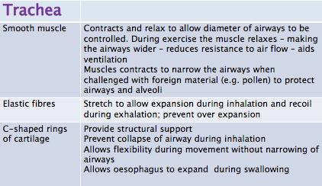
Structural Components of the Respiratory System

Slide 11
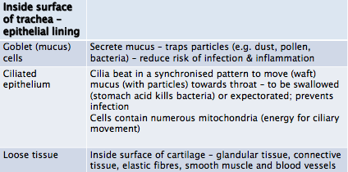
Structural Components of the Ventilatory System

Slide 12
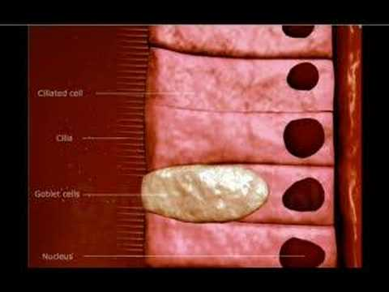
Structural Components of the Ventilatory System
Cilia: hair-like growths that move rapidly to keep dust particles out of the air passageway
Goblet Cells: secrete mucus
Notes:
You can see that cilia are interspersed with the goblet cells so they can work together

Slide 13
Structures of the Ventilatory System
Nose/Mouth
Pharynx
Larynx
Trachea
Bronchi
Bronchioles
Alveoli
Notes:
Recap the structure and function of the passageway of air

Slide 14
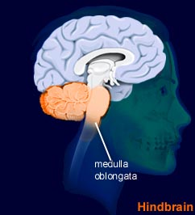
How do we breathe?
Breathing is an involuntary process controlled by the medulla oblongata
Medulla Oblongata is found in the brainstem of the Central Nervous System (CNS)
Notes:
Although it seems like a voluntary process at times, if this were the case, we would not continue to breathe in our sleep or when we are not paying attention.

Slide 15
How do we Breath?
Ventilation is a physical process, relying on the principle of Boyle’s Law.
“Pressure is inversely proportional to volume”
Gas will move along a gradient from high pressure to low pressure using a process called Diffusion.

Slide 16
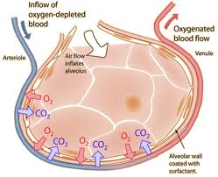
How do we breathe?
The lungs are constantly trying to keep the body at a state of homeostasis, therefore breathing oxygen in and breathing carbon dioxide out.
Notes:
What goes up must come down.. Refer to gravity as a way to help them remember that gases move from an area of high pressure to low pressure. If they remember this, they will find the process of gas exchange at the alveoli easier to remember

Slide 17
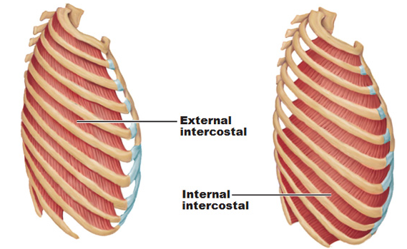
How Do We Breathe?
Muscles involved in breathing process at rest:
Diaphragm
Internal Intercostal Muscles – closest to the lungs and run downward and backward
External Intercostal muscles – found on top of the internal muscles and run downward and forward
Notes:
Internal - Closest to the lungs and go down and back (like putting your hands in your back pockets
External – found on top of internal and go down and forward (like putting your hands in your front pockets)
Question: What is the scientific term for breathing?? Answer: pulmonary ventilation

Slide 18
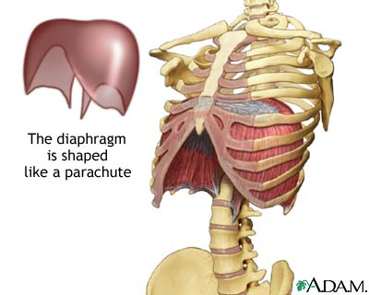
Diaphragm
A key structure for the function of pulmonary ventilation
Dome-shaped sheet of muscle under the chest cavity
Attached to vertebral column, lower ribs, and sternum

Slide 19
Activity
With a partner find your respiratory rate at rest. _______________
Now run on spot for 2 minutes and record your respiratory rate. _______
What happened? Why do you think this happened?
What happens to pressure in the lungs during inspiration and expiration?

Slide 20
Mechanics of Breathing

Slide 21
Breathing ‘In’ at Rest
Diaphragm contracts and attempts to flatten, which pulls the chest cavity down and stretches the lungs
At the same time, external intercostal muscles pull the ribcage together and upward, making the cavity bigger, increasing the volume
As volume increases, pressure decreases (inverse relationship)
With pressure in the lungs now lower than the atmosphere, air comes into the chest cavity until air pressure is equalized
Notes:
4) Bodies way of striving to reach that state of homeostasis

Slide 22
Breathing ‘Out’ at Rest
1) Diaphragm relaxes, returning to its dome shape, and intercostals relax, pushing ribs back into normal position
2) These two movements cause the volume of the chest cavity to decrease, which increases pressure (inverse relationship)
3) As air pressure in the lungs increases, air is forced out to equalize pressure

Slide 23
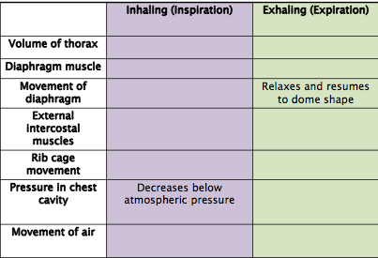
Complete this table!

Slide 24
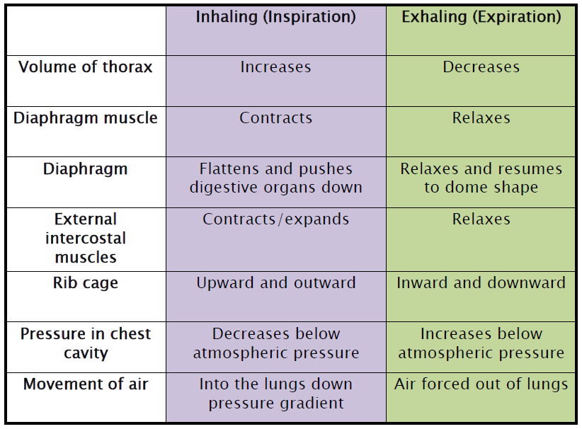

Slide 25
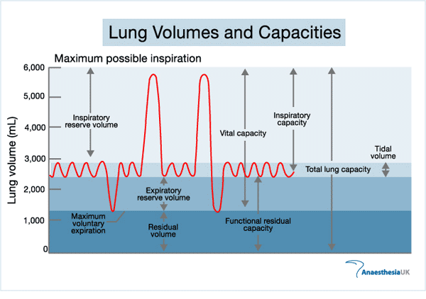
To Do: Page 35 Green Box

Slide 26
Important Terms to Know!
Pulmonary Ventilation: commonly known as breathing. Process of air flow into the lungs (inhalation) and out of the lungs (expiration).
Total Lung Capacity: volume of air in the lungs after a maximum inhalation
Vital Capacity: maximum volume of air that can be exhaled after a maximum inhalation
Tidal Volume: volume of air breathed in and out in any one breath

Slide 27
Important Terms to Know!
Expiratory Reserve Volume (ERV): volume of air that can be expelled forcibly from the lungs after a normal breath
Inspiratory Reserve Volume (IRV): volume of air that can be inspired above tidal volume
Residual Volume (RV): volume of air still contained in the lungs after a maximal exhalation
Notes:
Remind them that tidal volume is just a fancy way to describe a “normal breath”

Slide 28
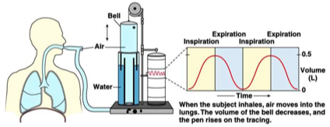
Measurement
Spirometer: A device that measures the volume of gas entering or leaving the mouth
Measures changes in lung volume
Measures subdivisions of vital capacity
Does NOT measure residual volume

Slide 29
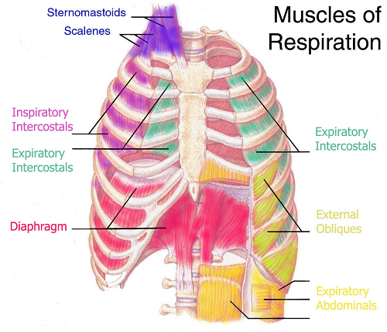
Breathing During Exercise - Inspiration
Diaphragm, Internal and External Intercostal Muscles still needed but when deeper breaths are taken as is necessary during exercise, more muscles are required to do the same work
Additional muscles are sternocleidomastoid, scalene, trapezius, and back and next extensors
Notes:
These muscles are contracting to lift the rib cage, increasing the volume of the chest cavity, to increase the amount of air that oxygen that can be taken in and transported to the working tissues and muscles

Slide 30
Breathing During Exercise - Expiration
Internal intercostal muscles and abdominal muscles contract to force air out of the lungs
It is the abdominal muscles that force the diaphragm upward to its normal position

Slide 31
Group Question – Why do you breath faster and deeper when exercising?

Slide 32
Breathing During Exercise p.35
Minute ventilation – the volume of air exhaled per minute
VE – minute ventilation
VT – Tidal Volume
Bf – Breathing Frequency
VE = VT x Bf

Slide 33
Nervous and Chemical Regulators of the Breathing
Respiratory Centre – Brainstem where Medulla Oblongata is found
pH – measure of blood acidity levels
pCO2 – measure of carbon dioxide in blood
pO2 – measure of oxygen levels in blood
Central Chemoreceptors – found in the Medulla Oblongata that detect changes in pH and CO2 levels
Peripheral Chemoreceptors – found throughout the body, detect changes in pH and CO2 levels

Slide 34
Chemical Regulators of Breathing
Detect changes in the blood pH and carbon dioxide content of the blood (pCO2)
When blood lactate levels rise as a result of anaerobic energy production in muscles, chemoreceptors react
Carbon dioxide, which is produced as a waste product during aerobic activity is the main regulator of breathing
Notes:
Again refer back to diffusion and CO2 being pushed out, O2 being brought in

Slide 35
Minor Regulators of Breathing during Exercise
Proprioceptors – sensors that report to the Medulla Oblongata about joint angles, muscle stretch, and balance
Lung Stretch Receptors – found in the bronchi and bronchioles to prevent overexpansion of lungs when breathing

Slide 36
Chemical Regulators During Exercise
Any change in the blood acidity level (pH) are detected by chemoreceptors
So, what does the body do?
Breathing rate and depth increases as a direct result of increases in carbon dioxide levels and increases in blood acidity levels (pH)
Notes:
Again bring back to body always trying to reach a state of homeostasis

Slide 37
Gas Exchange
Occurs in the lungs by process of diffusion across the semi-permeable membrane of the alveolar sac.
Blood pumped to the lungs from active tissues through the heart is lower in oxygen and higher in carbon dioxide.
Oxygen diffuses from the alveolus into the blood and carbon dioxide diffuses from blood into the alveolus
Notes:
Reminder that diffusion is the process where gas, in this case oxygen and carbon dioxide will move from an area of higher pressure to lower pressure.

Slide 38
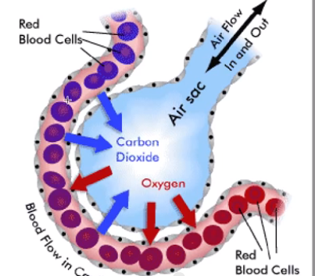
Gas Exchange
Notes:
Make a note that the red blood cells on the left are deoxygenated blood that has already been

Slide 39
Gas Exchange Continued

Slide 40
Gas Exchange
Deoxygenated blood goes from the muscles to the heart, which pumps it to the lungs to get more oxygen
The blood plasma which surrounds the red blood cells is high in carbon dioxide so it diffuses into the alveoli where it is eventually exhaled
Oxygen breathed in from the atmosphere is then diffused from the alveoli into the blood so that it can be transported to the working tissues in the body
Notes:
Again, this is the bodies way of reaching an equilibrium of o2 and co2, always striving to reach a state of homeostasis.

Slide 41
Gas Exchange

Slide 42
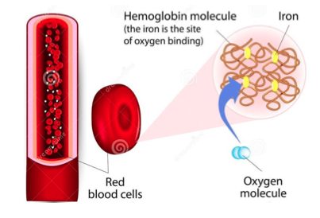
Hemoglobin
Hemoglobin are the tiny molecules which transport oxygen in red blood cells.
98.5 percent of oxygen in the blood is transported by hemoglobin

Slide 43
Review
In your own words, explain to me the mechanisms of breathing. Be sure to use correct terms.
How does breathing change during exercise?

